Slide 1
Researcher skills and career planning for academia and beyond Research Bazaar, 8 July 2024 Dr Victoria Hewitt, Researcher Developer

Slide 2
Today’s Plan
Make this useful for you - ask questions at any time!
Introduction – Who am I? Why am I here?
Researcher Development at UoA
ResearchHub resources
Capability pages
Events Calendar
Researcher Skills Development Fund
Induction SubHub
Next steps for Researcher Development

Slide 3
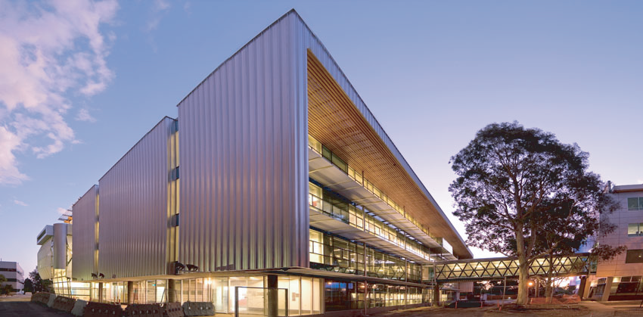
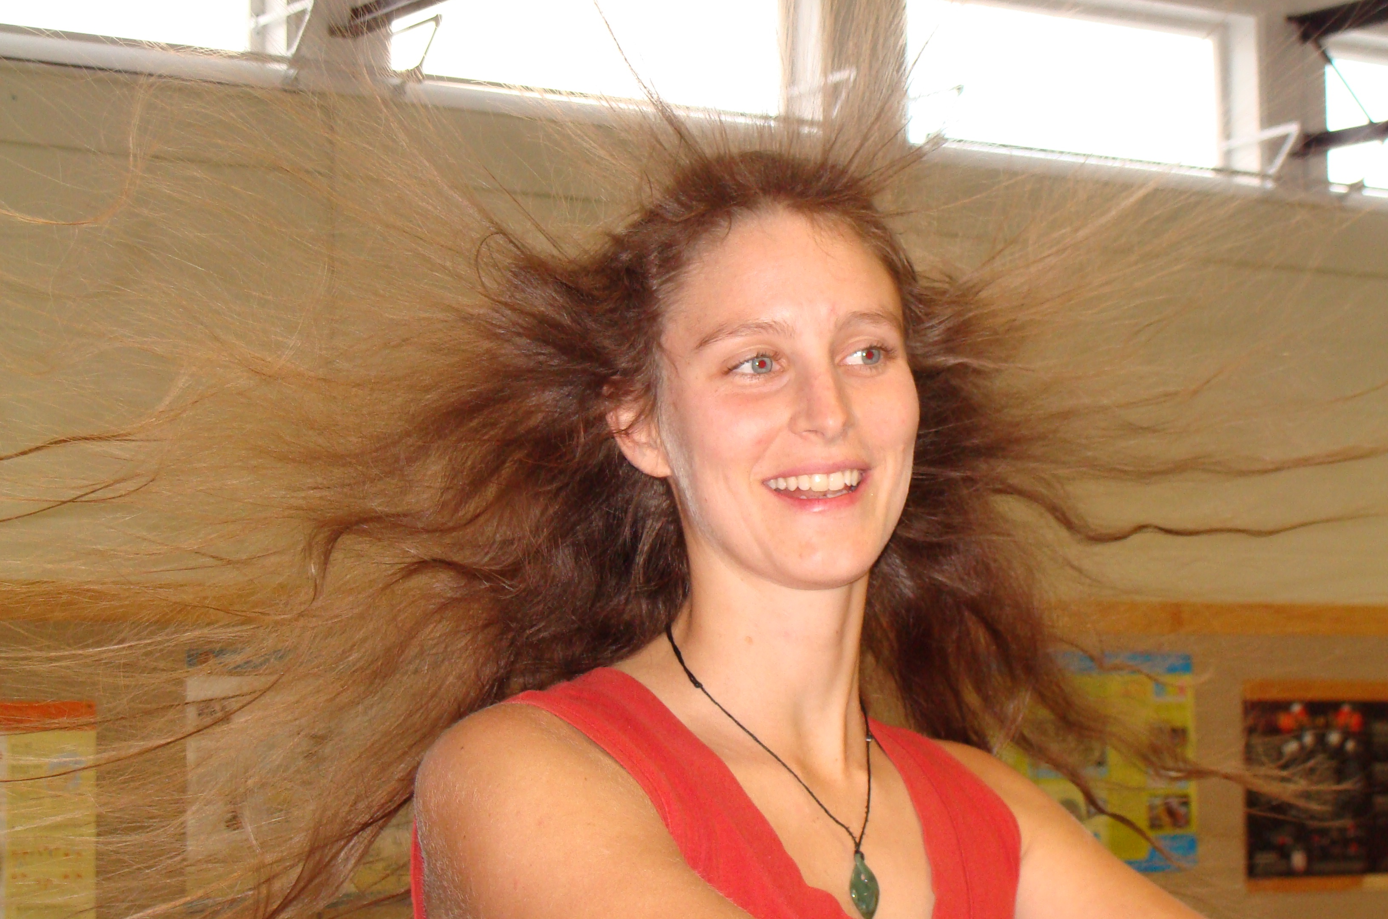
Undergrad to PhD

Slide 4
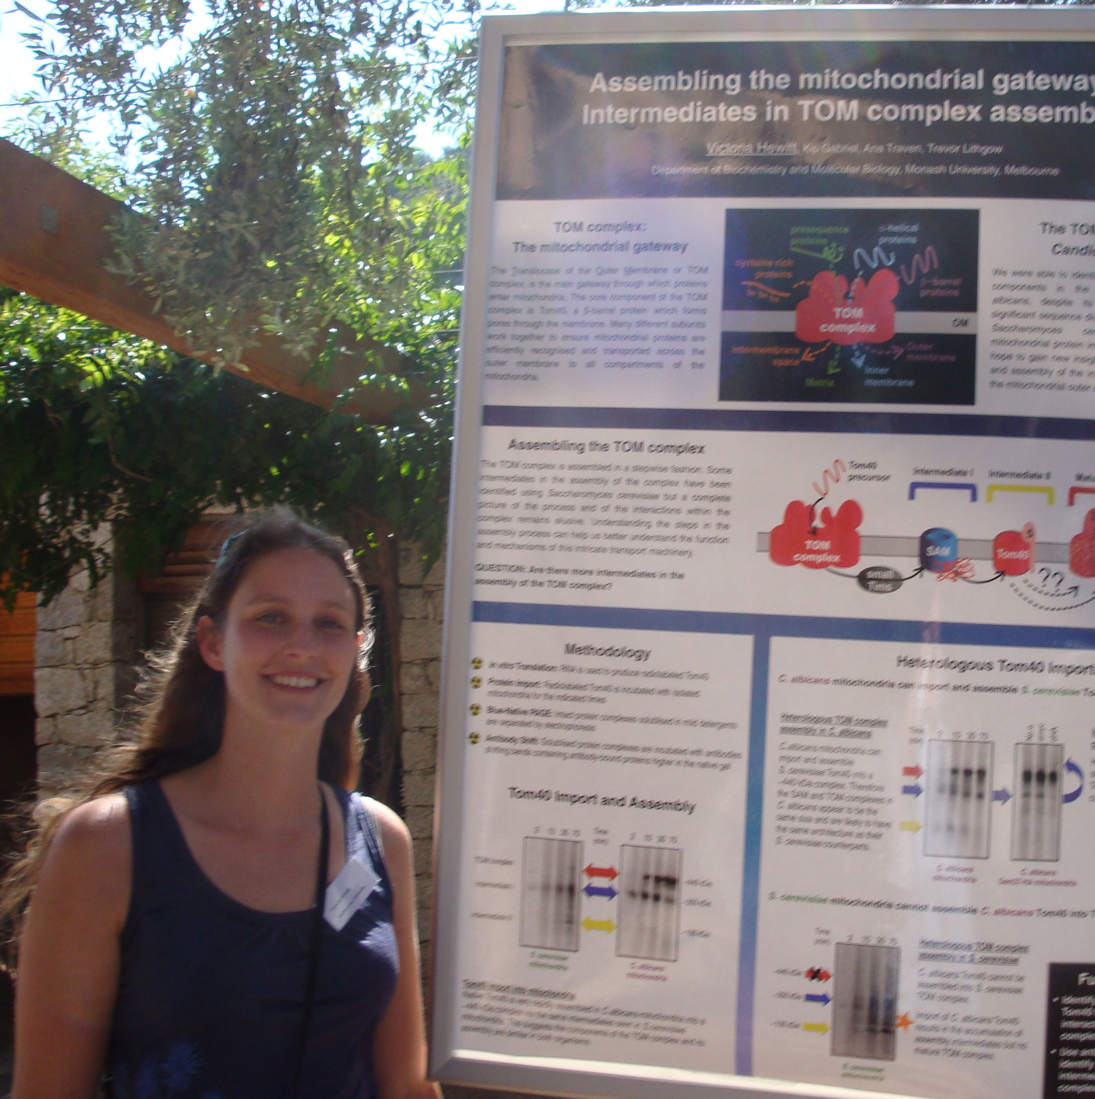
PhD

Slide 5
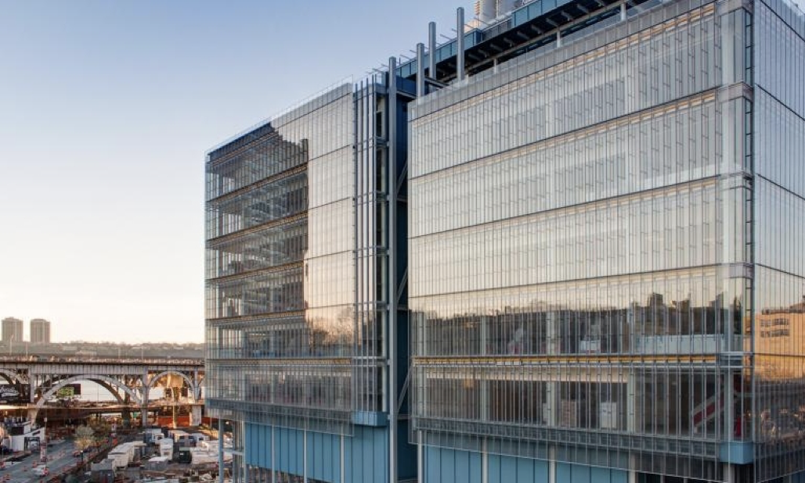
Postdoc & beyond

Slide 6
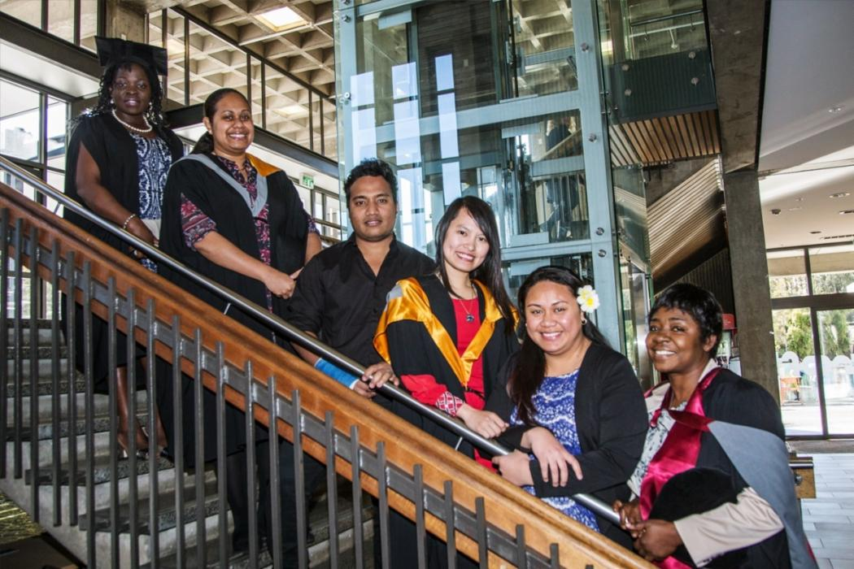
Reminder: You are a successful scholar!
Your strengths & skills:
Discipline specific knowledge
Creative & persistent
Driven & passionate
Writing & presentation skills
Organisation & time management
Notes:
Image credit: https://www.canterbury.ac.nz/study/graduation/
To be a successful researcher you must continue to develop these skills and gain more but it is OKAY if you are tired or ready for a change!

Slide 7
Skills and capabilities
What do we mean by skills and capabilities?
Researcher development goes beyond disciplinary knowledge and technical skills, includes skills like:
teamwork
communication
leadership
project management
understanding your research environment
NB: Can be learnt by training and/or by doing
Vitae, UK based professional development organisation
Notes:
https://www.vitae.ac.uk/researcher-careers/career-management-for-researchers

Slide 8
Notes:
https://research-hub.auckland.ac.nz/home

Slide 9
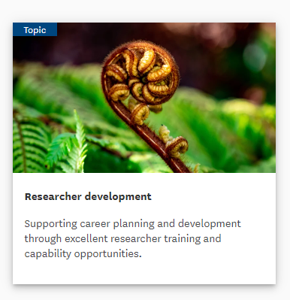
Skills and capabilities at UoA
Conducting and managing research
Project and financial management (including data management, risk assessment and management)
Research methods and digital skills
Research Environment and Collaboration
Responsible conduct of research and research ethics
Health, Safety, and Wellbeing
Responsiveness to and engagement with Māori and Pacifika
Building networks, collaboration, transdisciplinary research
Communication, engagement, impact
Leadership and supervision
Developing your researcher career
Research funding and commercialization
Notes:
https://research-hub.auckland.ac.nz/subhub/researcher-development

Slide 10
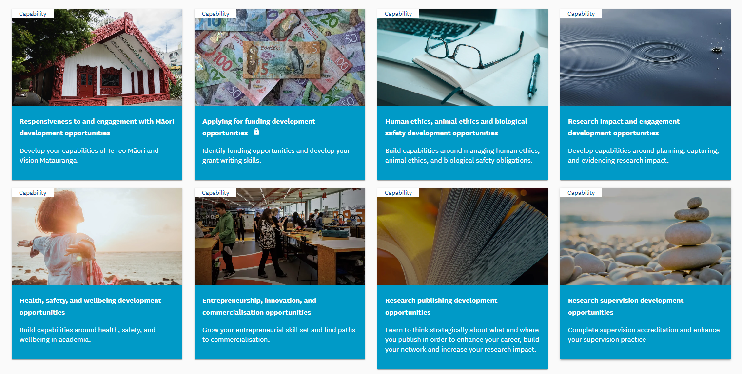
Capability Pages
Notes:
https://research-hub.auckland.ac.nz/subhub/researcher-development

Slide 11
Resources and Opportunities
Check what resources your institution and professional organisations have available for e.g postgraduate/doctoral students, international students, and for staff
CDES - Career Development and Employability Services - The University of Auckland
Capability/professional development programmes e.g Leadership programmes
Mentoring programmes
Travel funds & Funding support
Make your own!
Notes:
https://www.icearconference.com/

Slide 12
Career planning
Know
Explore
Plan
Do
Know yourself!
Self-awareness and self-reflection are vital and HARD
Ask yourself:
What am I good at? What are my strengths?
What am I passionate about? What motivates me?
What do I value in my work? Helping society? High salary?
What are your lifestyle constraints / opportunities?
Notes:
Whether you want a career in academia, industry, or if you are not really sure what is right for you, it is a really good idea to have a plan in place so you can explore options.

Slide 13
Career planning in academia
For an academic career:
Likely to need to move overseas or to another city if you want to secure your next role and/or a permanent position
Be aware of the requirements for academic continuation/tenure and promotions
Networking & establishing collaborations, are really important in NZ!
Top Tip: Maintain your connections with your home country if you think you might want to come back

Slide 14
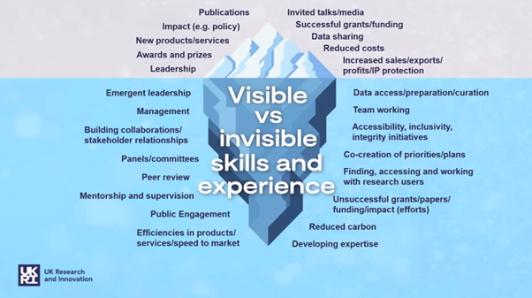
Career planning in academia
Stand out in your academic CV by highlighting things like:
Awards, prizes, funding
Engagement, outreach, impact
e.g news stories, public science article, community talks
Peer review (journals, grants), editorial work
considered an expert in your field internationally
Membership of professional bodies, committees
Conference posters/talks, invited talks
Supervision, mentoring
Researcher visits, international network
IP/patents
Top Tip: Use narrative CV guidelines to think about your skills and achievements
Notes:
Image credit
https://www.imperial.ac.uk/research-and-innovation/support-for-staff/scholarly-communication/bibliometrics/narrative-cvs/

Slide 15
Transferable skills for outside academia
Which do you have?
Communication – written / oral presentations
Critical thinking - fact/source checking
Problem solving / troubleshooting
Improving efficiencies / methodologies
Literature reviews - find and summarising information
Project management & collaboration

Slide 16
What do employers value/look for?
Ability to present ideas clearly (verbally, written)
Attention to detail/ thoroughness
Identify areas of change/improvement
Learn new software/programs/processes quickly and independently
Time management, meeting deadlines
Collaboration & Stakeholder engagement
Leadership
Project completion – independently and in teams
People they are connected to…
Notes:
https://careercenter.umich.edu/article/phd-transferable-skills

Slide 17
Who is in your network?
Map out your existing network
Identify areas where you would like more support
Appreciate the range of support/mentoring needs
Plan steps to maintain and build your network
Based on
Glessmer et al 2013
Notes:
Referees for new Royal Society fellowships eg

Slide 18
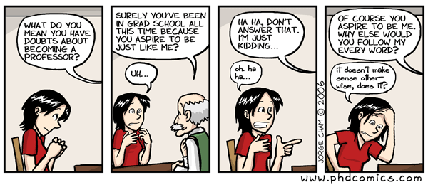
How can mentors help?
TIME!
Subject knowledge
Connections/collaborations
Details oriented/big picture
Teaching/mentoring skills
Easy to talk to/supportive
Shared experience/identities
Different goals/priorities
Notes:
Even if you supervisor is amazing they have a lot of responsibilities so its also useful to think about other types and sources of support

Slide 19
Get started!
Know
Explore
Plan
Go
Reflect and plan
Review and update
Don’t wait for a job opening – let people know you are keen for a particular role
Network, network, network!
Notes:
Use LinkedIn … find out about people’s paths and achievements in and out of academia – connect with me if you think what I’ve said sounds sensible

Slide 20
Thank you for listening, questions?
What’s your next step? More on networks and mentors? Academic jobs? Non-academic jobs? Contact:
Email me at: Victoria.Hewitt@auckland.ac.nz
Find out more about me in my discovery profile
Find out more about our Researcher Development Team

