Slide 1
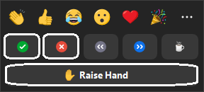
Introduction
to Version Control using Git
Noel Zeng, James Love and Shamim Shadfar
Setup Instructions: https://uoa-eresearch.github.io/git-novice/#installing-git
Ask questions in the chat at any time
Use ‘Raise Hand’ when asked for verbal responses
Use ‘Yes’ & ‘No’ reactions to indicate status
When you are ready to begin select ‘Yes’

Slide 2
He karakia - Tūtawa by Professor Scotty Morrison
Tūtawa mai i runga
Tūtawa mai i raro
Tūtawa mai i roto
Tūtawa mai i waho
Kia tau ai
Te mauri tū
Te mauri ora
Ki te katoa
Haumi ē! Hui ē!
Taiki ē!
Come forth from above,
below,
within,
and from the environment
vitality
and well being,
for all. Strengthened in unity.

Slide 3
Version control
Introduction to Automated Version Control
Setting up Git
Creating a Repository
Tracking Changes
Exploring History
Ignoring Things
Remotes in GitHub
Collaboration
Open Research, Licensing, Citation and Other Hosting Options
Break at 10:00am
Break at 11:00am

Slide 4
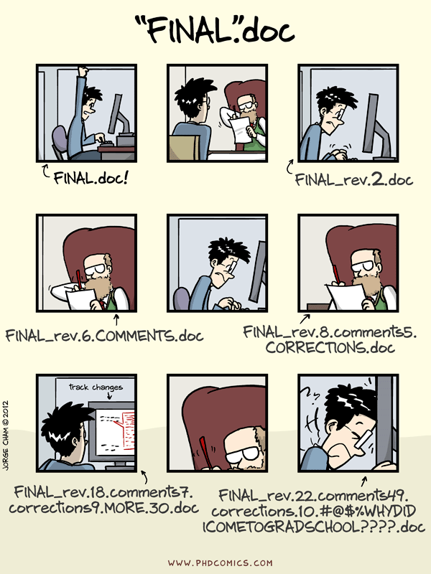
Version control: Make a copy of file
As we work on our project, we need to keep track of changes
One approach: Make a copy of your code, name it something else (e.g. script_edited.py, script_noels_changes.py)
It can work for smaller scripts, but…
Naming can become inconsistent.
You may forget which is the newest.
Folder and files gets messy.
Unworkable for larger set of files.
Makes collaboration hard
Notes:
If people have git installed but not in their path:
https://stackoverflow.com/questions/4492979/error-git-is-not-recognized-as-an-internal-or-external-command

Slide 5
A better approach - use a version control system
Version control system keeps track of the steps of changes it took to get to the latest version
Makes collaboration easier.
You decide what changes go into the each step (commit) of changes.
A directory of files using a version control system is called a repository.

Slide 6
Git: the most popular version control system for code
Originally created by Linus Torvalds in 2005.
Made for large software projects with many collaborators.
Many if not most research and industry software projects use it.
Originally used for tracking code, but also data and large documents like theses and papers.

Slide 7
GitHub: most popular Git hosting cloud service
Git is an open source program, GitHub is a commercial hosting service.
Why use a hosting service? Backup. Collaboration. Discover new projects helpful to you.
Large number of projects hosted on there.

Slide 8
Scenario: Aspiring cookbook authors
For simplicity, we won’t be working with code today.
Instead, we’re writing recipes!
Sarah and Kai are each writing their own cookbooks.
They want to collaborate on some recipes, but back and forth email drafts are becoming unmanageable. So they’re giving Git a try.
Megan Bucknall on Unsplash

Slide 9
Version control
Introduction to Automated Version Control
Setting up Git
Creating a Repository
Tracking Changes
Exploring History
Ignoring Things
Remotes in GitHub
Collaboration
Conflicts
Open Research, Licensing, Citation and Other Hosting Options

Slide 10
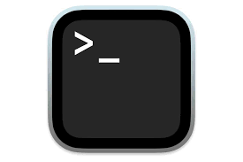
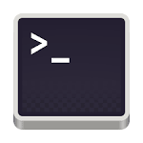
Let’s jump into the Unix shell!
Windows Start Menu > Git > Git Bash
macOS Dock > Terminal or Finder > Applications > Utilities > Terminal Then, type bash and press Enter
Linux Activities > type Terminal or Sidebar > Terminal

Slide 11
The git command(s)
$ git verb options
Notes:
Make sure people can run git with git - - version. If they can’t:
Is it installed? (if not follow install instructions)
Is it in the path? If not add to the path or use git bash on windows

Slide 12
How do I set up SSH authentication?
id_ed25519
id_ed25519.pub
id_ed25519.pub

Slide 13
git cheatsheet
git config # Change per-repository and per-device settings.
ssh-keygen # Create new SSH key pair files, needed for each new device.

Slide 14
Version control
Introduction to Automated Version Control
Setting up Git
Creating a Repository
Tracking Changes
Exploring History
Ignoring Things
Remotes in GitHub
Collaboration
Conflicts
Open Research, Licensing, Citation and Other Hosting Options

Slide 15
git cheatsheet
git config # Change per-repository and per-device settings.
ssh-keygen # Create new SSH key pair files, needed for each new device.
git init # Initialise the directory into a repository

Slide 16
Version control
Introduction to Automated Version Control
Setting up Git
Creating a Repository
Tracking Changes
Exploring History
Ignoring Things
Remotes in GitHub
Collaboration
Conflicts
Open Research, Licensing, Citation and Other Hosting Options

Slide 17
Add our first guacamole recipe using nano
yakshi virmani on Unsplash

Slide 18
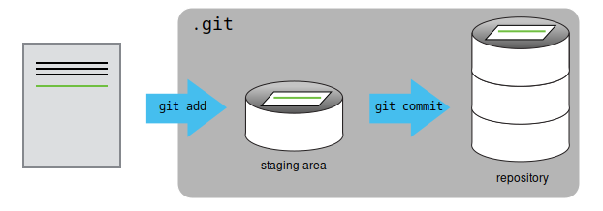
The staging area
git add specifies what will go into a snapshot, git commit actually takes a snapshot and creates a permanent record.
Multiple files can go into the staging area before a commit - allows you to create logical portions, rather than single file changes or a big mixed batch.
You can add all changed files to the staging area (git add -a), but it’s better to go one-by-one to select only the changes you do want to keep.

Slide 19
A good commit message...
<50 characters
Describes what you did and why
Completes the sentence “If applied, this commit will…”
If you need to put in more details, add blank line between summary and additional notes.
“Improve recipe with more vegetables”
“Add capsicum in soup”
“Fix bug with incorrect calculations”
“asdf”
✅
❌
https://cbea.ms/git-commit/

Slide 20
Exercise: Choosing a Commit Message
Which of the following commit messages would be most appropriate for the last commit made to mars.txt? Why do you think it is?
“Changes”
“Changed lemon to lime”
“Guacamole modified to the traditional recipe”

Slide 21
Exercise: Committing Changes to Git
Which command(s) below would save the changes of myfile.txt to my local Git repository?
$ git commit -m "my recent changes"
$ git init myfile.txt $ git commit -m "my recent changes"
$ git add myfile.txt $ git commit -m "my recent changes"
$ git commit -m myfile.txt "my recent changes"
Notes:
4. Is wrong but very close to “git commit -i myfile.txt -m “my recent changes”” which is a valid answer

Slide 22
Challenge: A new repository
Create a new Git repository on your computer called bio (outside the recipes repository)
Write three facts about yourself in a file called `me.txt`, commit your changes
Modify one of the facts, add a fourth fact
Display the differences between its updated state and its original state.
Hint: Here are some commands we’ve learned so far. Not all are relevant.
$ git diff $ git log $ git commit -m “[message]” $ git init $ git add [file path]
$ mv [source] [destination] $ mkdir [directory name] $ nano [file name] $ ls [directory name] $ cd [directory path]

Slide 23
git cheatsheet
git config # Change per-repository and per-device settings.
ssh-keygen # Create new SSH key pair files, needed for each new device.
git init # Initialise the directory into a repository
git add # Adds changes to staging area
git commit -m “message” # Creates a new commit with changes in staging area
git log # Show a log of past commits
git diff # Show difference between commits
🍵

Slide 24
Version control
Introduction to Automated Version Control
Setting up Git
Creating a Repository
Tracking Changes
Exploring History
Ignoring Things
Remotes in GitHub
Collaboration
Conflicts
Open Research, Licensing, Citation and Other Hosting Options

Slide 25
How do we refer to our past commits in git?
(Unique 40-character ID)
HEAD
(Unique 40-character ID)
HEAD~1
(Unique 40-character ID)
HEAD~2
…
…

Slide 26
What’s changed since an older commit
$ git diff [identifier] guacamole.txt

Slide 27
Discard changes since the most recent commit
$ git checkout HEAD guacamole.txt
or
$ git checkout -- guacamole.txt

Slide 28
Restore an older version of the file
$ git checkout [identifier] guacamole.txt
This brings back the older version of the file into the staging area.
You can cancel the restoration by running $ git checkout HEAD guacamole.txt.
Or run $ git commit to finalise the restoration!
If you want to undo a particular change, remember to use the identifier BEFORE when the change happened.

Slide 29
Detached HEAD
What if you run…
$ git checkout [identifier] (without a specific file)
It does something different! 😱
Goes into a “detached HEAD” state
Shows the whole repository’s state at this commit.
“Look, don’t touch” mode - don’t make any changes here.
$ git status confirms you’re in this mode
$ git checkout main to reattach HEAD.

Slide 30
Exercise: Understanding workflow and history
What is the output of the last command?
$ cd recipes $ (Use nano to create a file called ketchup.txt, adding content "I like tomatoes, therefore I like ketchup") $ git add ketchup.txt $ (Use nano to delete the content in ketchup.txt, and replace with "ketchup enhances pasta dishes") $ git commit -m "my opinions about ketchup" $ git checkout HEAD ketchup.txt $ cat ketchup.txt # this will print the content of ketchup.txt on screen
ketchup enhances pasta dish
I like tomatoes, therefore I like ketchup
I like tomatoes, therefore I like ketchup ketchup enhances pasta dishes
Error because you have changed ketchup.txt without committing the changes

Slide 31
Challenge: git diff
Consider this command: git diff HEAD~9 guacamole.txt. What do you predict this command will do if you execute it? What happens when you do execute it? Why?
Try another command, git diff [ID] guacamole.txt, where [ID] is replaced with the unique identifier for your most recent commit. What do you think will happen, and what does happen?

Slide 32
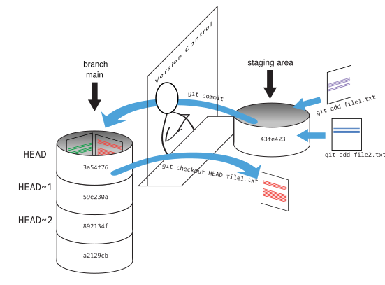
Putting it all together…

Slide 33
git cheatsheet
git config # Change per-repository and per-device settings.
ssh-keygen # Create new SSH key pair files, needed for each new device.
git init # Initialise the directory into a repository
git add # Adds changes to staging area
git commit -m “message” # Creates a new commit with changes in staging area
git log # Show a log of past commits
git diff # Show difference between commits
git checkout # Discard uncommitted changes or restore an older version of a file

Slide 34
Version control
Introduction to Automated Version Control
Setting up Git
Creating a Repository
Tracking Changes
Exploring History
Ignoring Things
Remotes in GitHub
Collaboration
Conflicts
Open Research, Licensing, Citation and Other Hosting Options

Slide 35
Asking git to ignore files and directories
Some files don’t need to go into version control
Generated files, automatic backup files created by text editors
Add them to a .gitignore file
Can use wildcard character (*) to ignore files matching a pattern

Slide 36
Exercise: Including specific files
How would you ignore all .dat files in your root directory except for final.dat?
Hint: Find out what ! (the exclamation point operator) does.
Notes:
Maybe hard for people to google the ! operator

Slide 37
git cheatsheet
git config # Change per-repository and per-device settings.
ssh-keygen # Create new SSH key pair files, needed for each new device.
git init # Initialise the directory into a repository
git add # Adds changes to staging area
git commit -m “message” # Creates a new commit with changes in staging area
git log # Show a log of past commits
git diff # Show difference between commits
git checkout # Discard uncommitted changes or restore an older version of a file
Add a .gitignore file to ignore files git doesn’t need to keep track of.

Slide 38
Version control
Introduction to Automated Version Control
Setting up Git
Creating a Repository
Tracking Changes
Exploring History
Ignoring Things
Remotes in GitHub
Collaboration
Conflicts
Open Research, Licensing, Citation and Other Hosting Options

Slide 39
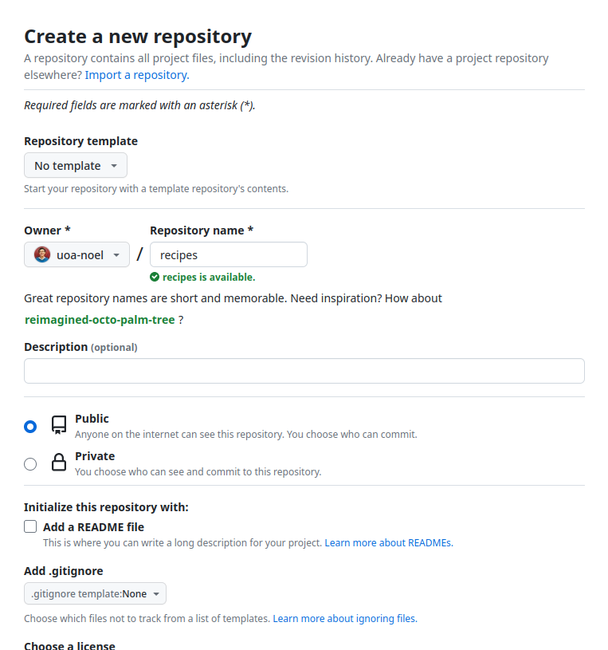
Creating a repository on GitHub
Equivalent of running this on GitHub’s server:
$ mkdir recipes $ cd recipes $ git init

Slide 40
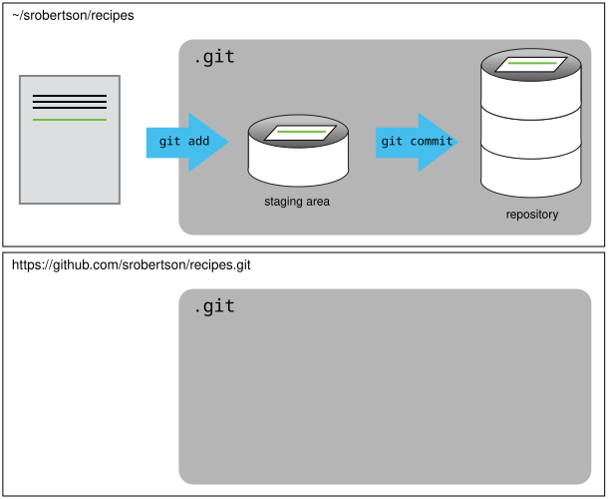
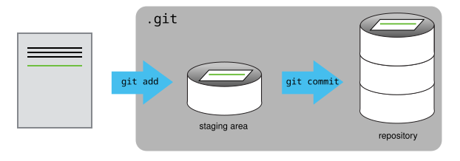
Our repository

Slide 41
Connect with a remote repository
$ git remote add [name] [url]
The name is a local label you can use to refer to the remote repository. “origin” is commonly used by convention.
You can also have multiple remotes. This is useful to look into when you are working with a larger project.

Slide 42
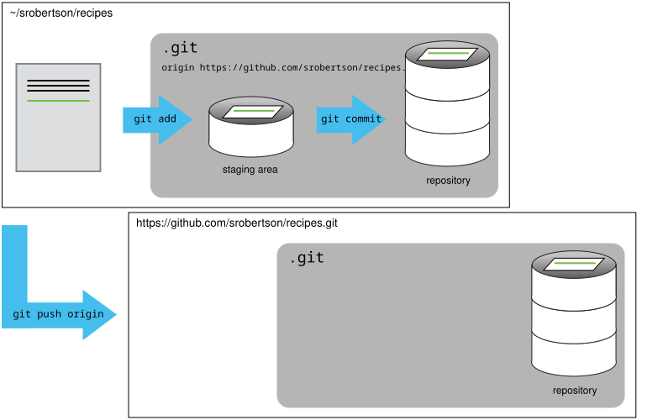
Effect of git push

Slide 43
Push changes to a remote repository
$ git push [remote name] main
Add the -u option (e.g. git push -u origin main) to associate the current branch with a remote branch, so you can use git pull without specifying any arguments. This only needs to be done once.

Slide 44
Pull changes from a remote repository
$ git pull [remote name] main

Slide 45
Exercise: git push vs git commit
In this episode, we introduced the “git push” command. How is “git push” different from “git commit”?
git push records staged changes into your local repository and synchronises all your changes with a remote repository. git commit only does the first part.
git push synchronises all your changes with a remote repository. git commit records staged changes into your local repository.
git push records staged changes into your local repository. git commit synchronises all your changes with a remote repository.
git push only records changes into your local repository. git commit does that and synchronises all your changes with a remote repository.

Slide 46
git cheatsheet
…
git add # Adds changes to staging area
git commit -m “message” # Creates a new commit with changes in staging area
git log # Show a log of past commits
git diff # Show difference between commits
git checkout # Discard uncommitted changes or restore an older version of a file
Add a .gitignore file to ignore files git doesn’t need to keep track of.
git remote # connect or disconnect with remote repositories
git push and git pull # push local changes to remote repository and pull remote changes to local repository

Slide 47
For the next section…
For the next section we will be splitting you into pairs. Please add your username and repository address (e.g. https://github.com/AnthonyDShaw/recipes) to the spreadsheet at the following link. The link will also be in the chat.
https://tinyurl.com/5x75v69k
🍵

Slide 48
Version control
Introduction to Automated Version Control
Setting up Git
Creating a Repository
Tracking Changes
Exploring History
Ignoring Things
Remotes in GitHub
Collaboration
Conflicts
Open Research, Licensing, Citation and Other Hosting Options

Slide 49
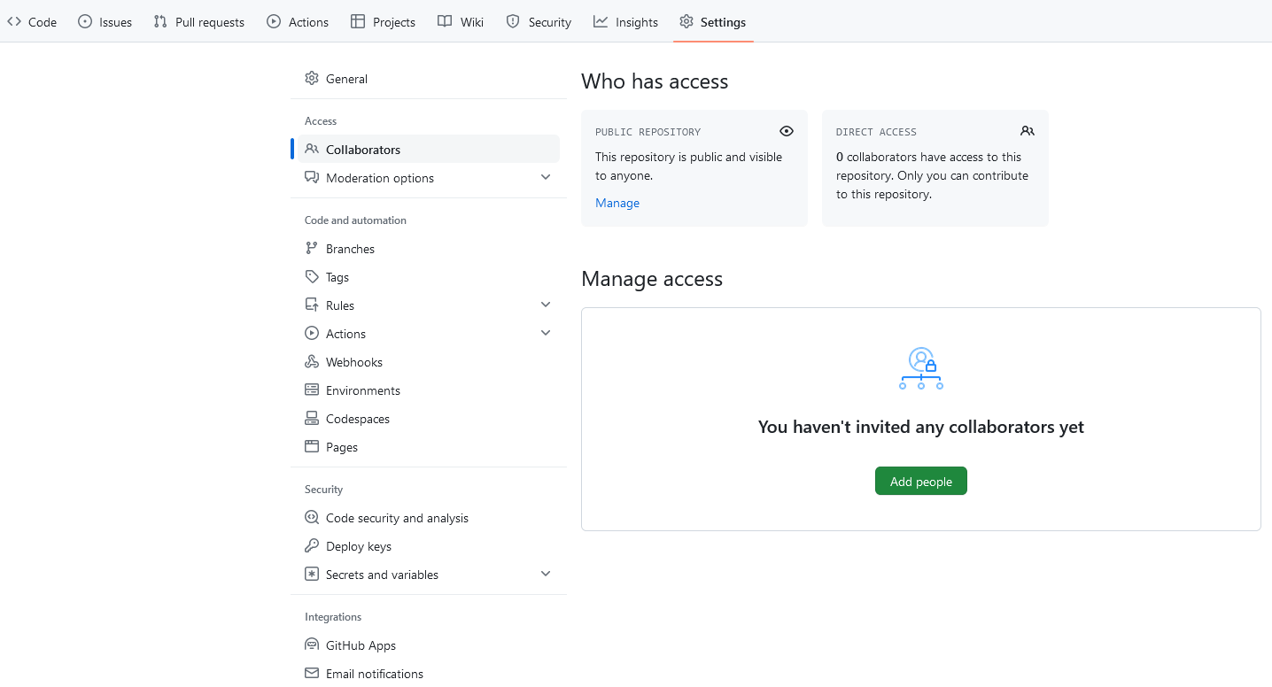
Collaborating: Adding a collaborator
Once partners are made give your partner Collaborator access to your repository. On GitHub, click the “Settings” button on the right, select “Collaborators”, click “Add people”, and then enter your partner’s username.
To accept access to the Owner’s repo, the Collaborator needs to go to their partner’s repository, or check for email notification

Slide 50
Collaborating: Making a change as the Collaborator
$ git clone git@github.com:AnthonyDShaw/recipes.git ~/Documents/anthony-recipes #Clone your partners repository and rename it
$ cd ~/Documents/anthony-recipes $ nano soup.txt #Create a file with a new recipe
$ git add soup.txt #Stage the file $ git commit -m "Add ingredients for soup" #Commit the file
$ git push origin main #Push the file to the owners repository

Slide 51
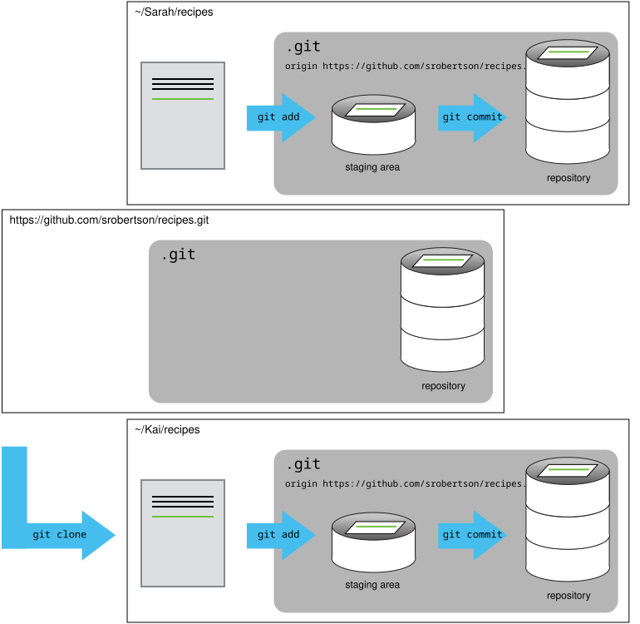
Our repository after cloning

Slide 52
Collaborating: Checking the change as the Owner
$ git pull origin main #Pull the file from your repository
$ cat soup.txt #Check the changes to the file

Slide 53
Collaborating: Reviewing changes
If the commit message is not clear on the changes you can use git fetch origin main to get the remote changes and then use git diff main origin/main to compare. Alternatively, you can go to the repository, click commits and view the most recent commits.

Slide 54
Collaborating: Summary
In this section we:
Learned how to clone someones repository with git clone
Used git push to make a change to this repository
Used git pull to retrieve a change to your local repository
Noted how to use git fetch and git diff or the webpage to check changes between commits when the commit message is unclear

Slide 55
git cheatsheet
…
git log # Show a log of past commits
git diff # Show difference between commits
git checkout # Discard uncommitted changes or restore an older version of a file
Add a .gitignore file to ignore files git doesn’t need to keep track of.
git clone # Copies an online repository to your local machine
git pull # Updates your local copy of the repository with any changes made to the online repository
git push # Updates the online repository with the changes you committed in your local repository
Notes:
End on this slide, wait for everyone to catch up if we have time progress to conflicts or swap roles for collaboration.

Slide 56
Version control
Introduction to Automated Version Control
Setting up Git
Creating a Repository
Tracking Changes
Exploring History
Ignoring Things
Remotes in GitHub
Collaboration
Conflicts
Open Research, Licensing, Citation and Other Hosting Options

Slide 57
Conflicts
To simulate a Collaborator making a change independently from you:
Go to your Github repository (e.g. https://github.com/AnthonyDShaw/recipes)
Select the guacamole.md file
Select “edit this file” (the pencil near the top right corner)
Add a new line
Commit the changes with the commit message: First step on the instructions

Slide 58
Conflicts: Creating a conflict
Now let’s create a conflict in our local repository. Each of us will make a change to the guacamole.txt file in our local repository associated with git@github.com:AnthonyDShaw/recipes.git
$ nano guacamole.txt #add a line
$ git add guacamole.txt #Stage the file
$ git commit -m "First step on the instructions" #Commit the file
$ git push origin main #Try to push the file to git
Git rejects the second person to push because it detects that the remote repository has new updates that have not been incorporated into the local branch. Now let’s resolve the conflict.

Slide 59
Conflicts: Resolving conflicts
$ git pull origin main #Attempt to pull the conflict repository from GitHub
$ git config pull.rebase false # Set default merge divergent branch strategy (if not already set) $ git pull origin main #Pull the conflict repository from GitHub
$ nano guacamole.txt #Resolve the conflicted areas $ git add guacamole.txt #Stage the merged file
$ git commit -m "Merge changes from GitHub" #Commit the merged file
$ git push origin main #Push the merged file to GitHub
$ git pull origin main #Pull the merged file from Github
cat guacamole.txt #Confirm the conflict is resolved

Slide 60
Conflicts on non-text files
When trying to merge non-text files such as images you will get a warning saying “Cannot merge binary files”. Meaning git cannot insert conflict markers as it did for the text file example.
The available version of the file with be HEAD (your version) and an alphanumeric code (the alternative conflicting version) shown in the warning message.
You can use git checkout HEAD conflicting_file.jpg or git checkout [identifier] conflicting_file.jpg to chose which file to keep.
Alternatively, you can keep both images by checking out and renaming itching file with the mv command (e.g. mv conflicting_file.jpg new_name.jpg.

Slide 61
Conflicts: Avoiding conflicts
Pull from upstream more frequently, especially before starting new work
Use topic branches to segregate work, merging to main when complete
Make smaller more atomic commits
Push your work when it is done and encourage your team to do the same to reduce work in progress and, by extension, the chance of having conflicts
Where logically appropriate, break large files into smaller ones so that it is less likely that two authors will alter the same file simultaneously
Clarify who is responsible for what areas with your collaborators
Discuss what order tasks should be carried out in with your collaborators so that tasks expected to change the same lines won’t be worked on simultaneously
If the conflicts are stylistic churn (e.g. tabs vs. spaces), establish a project convention that is governing and use code style tools (e.g. htmltidy, perltidy, rubocop, etc.) to enforce, if necessary

Slide 62
Conflicts: Summary
In this section we:
Intentionally pushed two conflicting changes of the same file to the GitHub repository
Edited the conflicting file and pushed the file back to the GitHub repository after resolving the conflict
Noted how this method won’t work with non-textual files, such as binaries, and that you will need to use git checkout to choose a conflicting file to keep, or rename one of the conflicting files to keep both

Slide 63
git cheatsheet
…
git log # Show a log of past commits
git diff # Show difference between commits
git checkout # Discard uncommitted changes or restore an older version of a file
Add a .gitignore file to ignore files git doesn’t need to keep track of.
git clone # Copies an online repository to your local machine
git pull # Updates your local copy of the repository with any changes made to the online repository
git push # Updates the online repository with the changes you committed in your local repository

Slide 64
Git can enable open science and research
Publishing data and code make research reproducible, transparent and open for reuse.
In one study, publications with publicly available data had a 69% increase in citations. (Piwowar et al 2007)
You can test how reusable your results are by asking a colleague to try reproducing it based on what you’ve published.
Check out University of Auckland’s Figshare space and Zenodo.

Slide 65
Licensing your code
To make your code reusable, choose a free and open source copyright license and use it!
Varying conditions ranging from requiring attribution, requiring users make their changes open source, to requiring the code be used ethically.
Add a LICENSE or LICENSE.txt file in your Git repository to tell others.
www.choosealicense.com

Slide 66
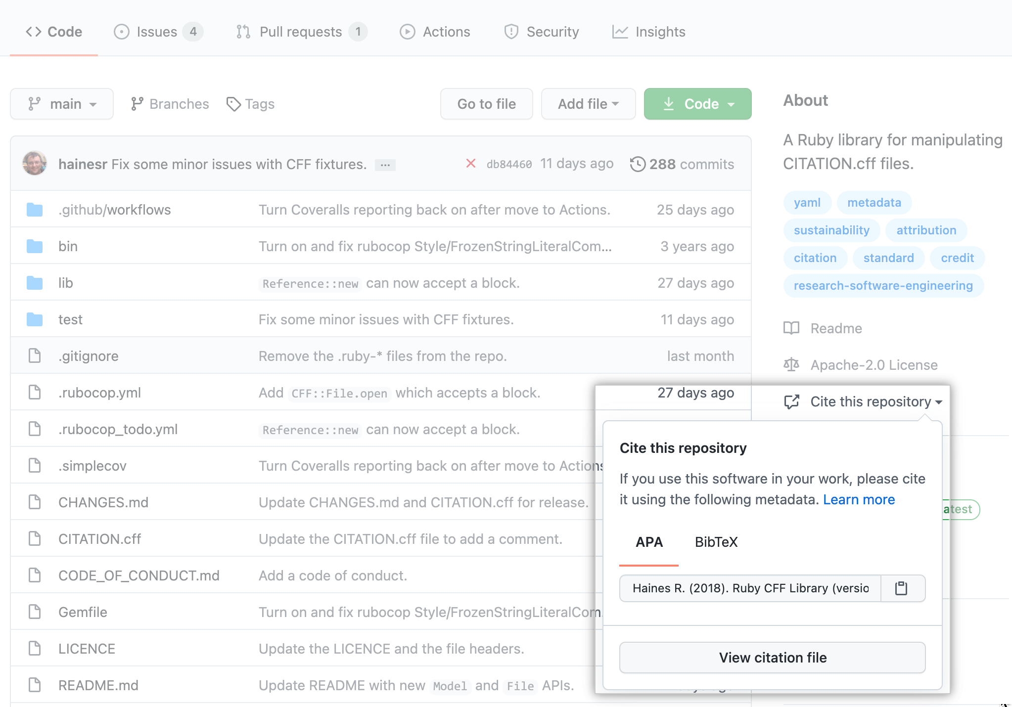
Make your code citable
You can include a CITATION or CITATION.txt in the Git repository with instructions on how to cite your software.
GitHub shows a citation popup if you include a CITATION.cff file.
More information: https://swcarpentry.github.io/git-novice/12-citation/index.html

Slide 67
Where to host your Git repository?
We’ve looked at GitHub today, but there are other Git hosting services. You can also run a Git hosting server yourself.

Slide 68
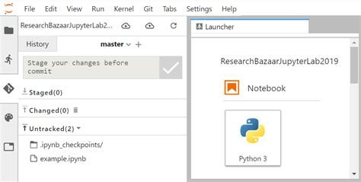
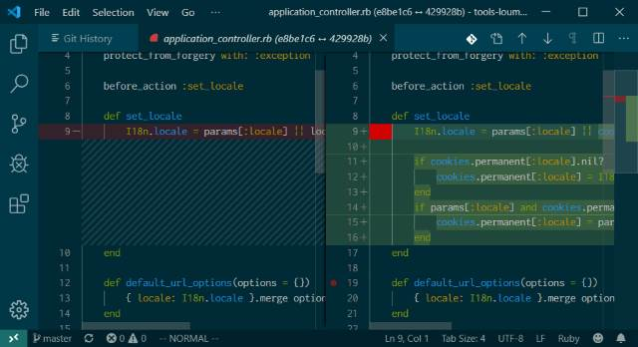
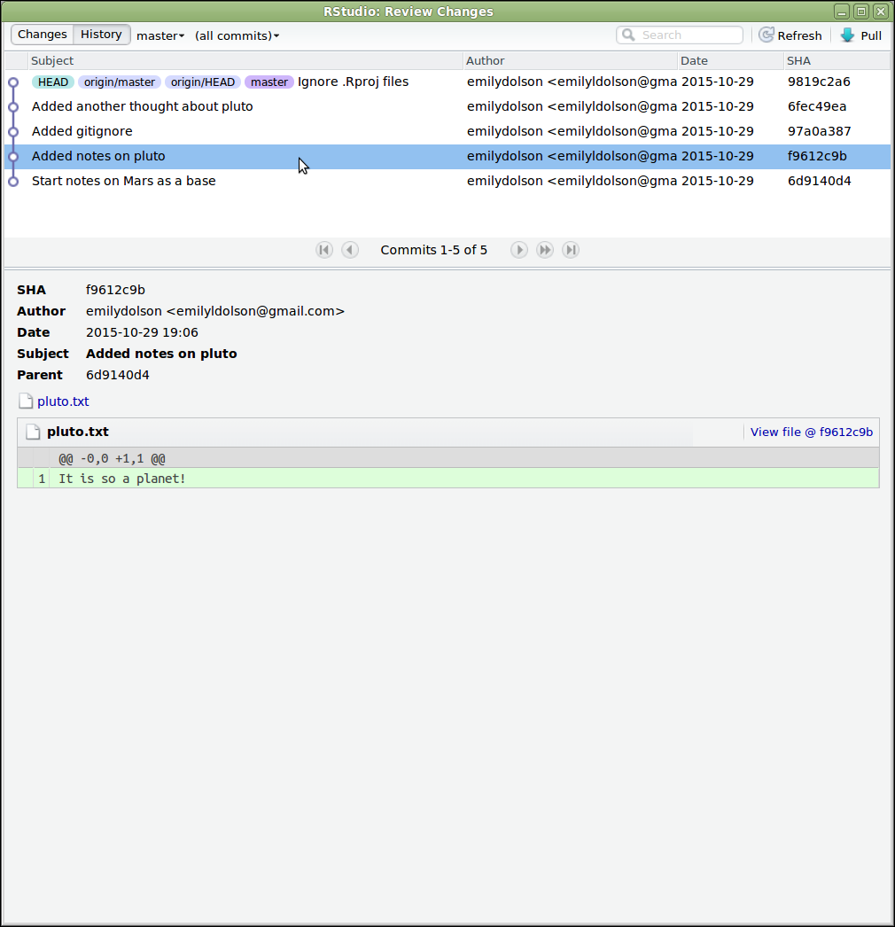
Git integration in code editors
Many GUI code editors provide graphical Git integrations, so you don’t have to use the git command directly.
However, they may be missing more advanced features.
JupyterLab
VSCode
RStudio

Slide 69
Version control: Summary
Automated version control can help with larger projects and collaboration on code.
For each computer you use git on, you need to set up authentication and preferences.
A directory using version control is called a repository. Change history (i.e. the list of commits) is stored in a .git folder.
You can choose the changes that go into a commit, adding a description with each.
You can look at past commits and restore an older version of your files.
GitHub is an online Git hosting service. You can set up a remote repository on there and sync it with local ones.
People can collaborate by connecting to a remote repository. Git provides tools for detecting and resolving conflicts.
You can make research better for everyone by sharing your code, also by choosing a license that enables reuse, and by making it easier to cite your code.
There are alternatives to GitHub, and graphical interfaces that make it easier to work with Git. However, commandline git is still useful for trickier situations.

Slide 70
Congratulations, you finished Software Carpentry!

Slide 71
He karakia whakakapi - Professor Scotty Morrison
Te whakaeatanga e
Te whakaeatanga e
Tēnei te kaupapa ka ea
Tēnei te wānanga ka ea
Ko te mauri o te kaupapa ka whakamoea
Ko te mauri o te wānanga ka whakamoea
Koa ki runga, koa ki raro
Haumi e, hui e, tāiki e
It is completed,
it is done,
we have achieved our purpose,
completed our forum,
let the purpose of our gathering rest for now,
let the vitality of our discussions replenish,
we depart with fulfilled hearts & minds,
bonded in our common goal & unity

