Slide 1
Introduction to programming with Python
Hands-on session to make your research better
Ben Collings, Victor Gambarini, Jens Brinkmann
July 2024

Slide 2
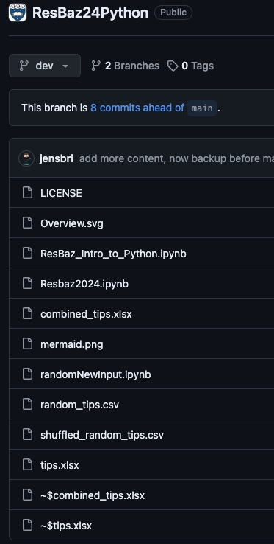
ADDONS
TO TALK ABOUT:
RANDOM TIPS GENERATED
APPEND DATAFRAME

Slide 3
Code of Conduct
PASTE HERE

Slide 4
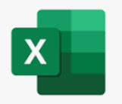
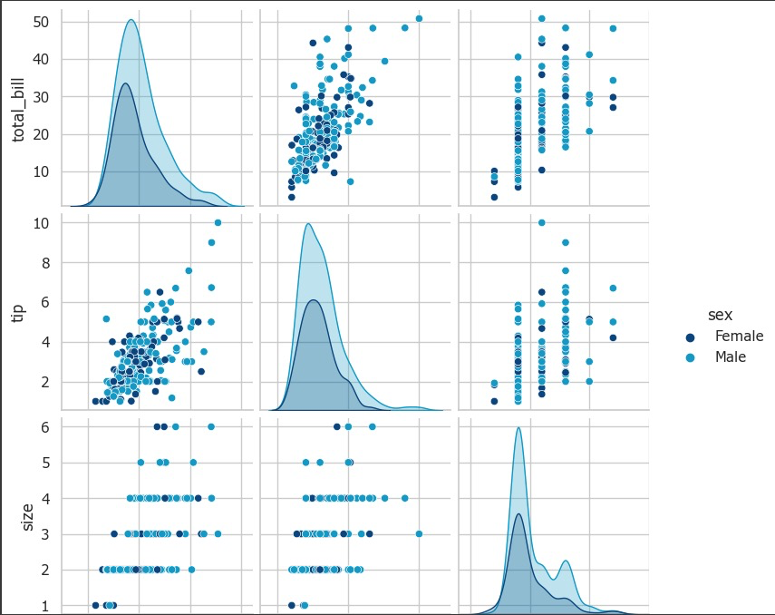
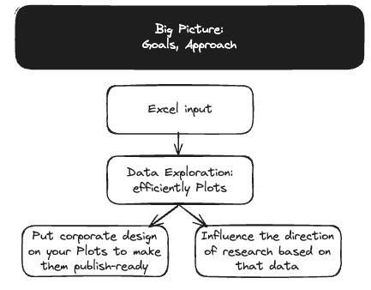
Agenda
This will be the super neat plot that we will create based on an Excel sheet and this will be consistently updating
And we will easily create updates to the plot once the data updates
And we can have several kinds of plots where things like colour-blindness/red-green vs. blue-yellow etc. has already been taken care of, etc.
Intro (Jens)
First steps using Python (Ben)
Next steps (Victor)
Plotting (Jens)
Outro/Links (Jens)

Slide 5
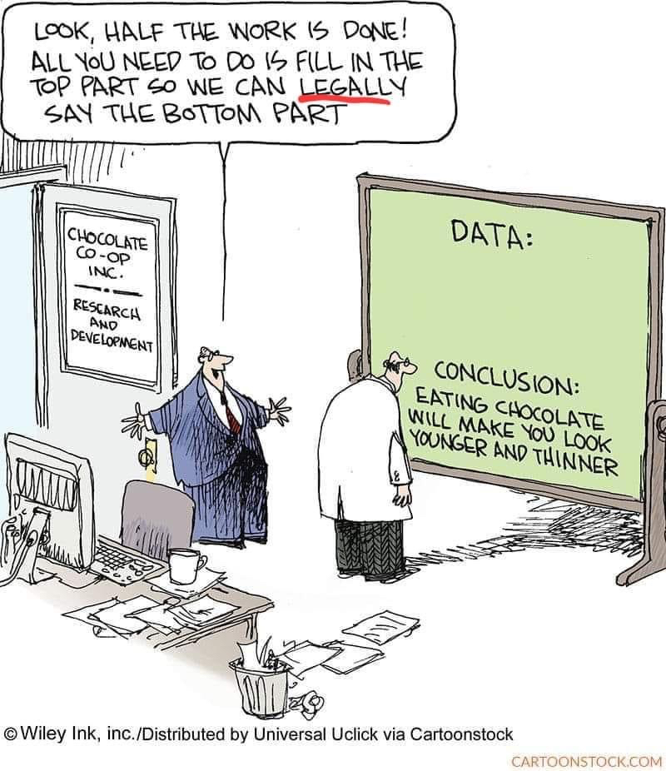
Explorative Data Analysis (EDA)
PASTE HERE

Slide 6
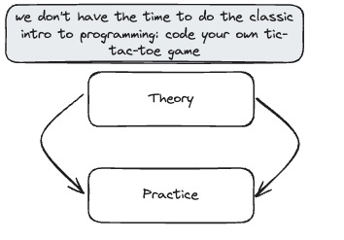
Background
This is a hands-on session/live-coding. This is a big topic to cover. You likely need to be on your tip-toes. We tried to streamline the process (we don’t install Python locally, we get you to focus on the code) To facilitate learning, we make use of
Repetitions (we start with the concept overview), we do some coding, we come back
Breaks
Breaks with Q&A
Feedback
Have helpers assist you
We have one example of creating neat plots from Excel data

Slide 7
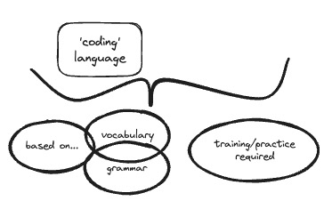
Why not workarounds
Think of the woodcutter with the blunt axe
Roughly paraphrased from The 7 Habits of Highly Effective People Dr. Stephen R Covey

Slide 8
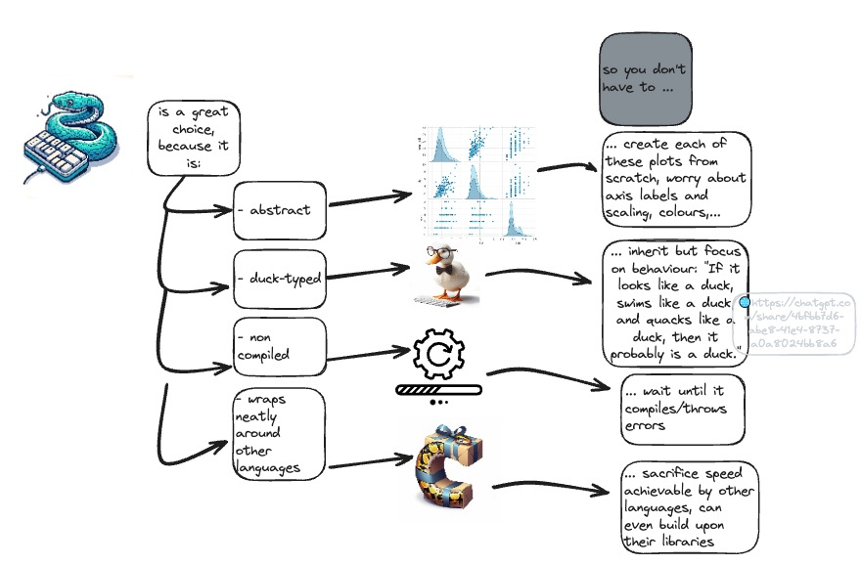
Why Python and not other langugaes
Because it is awesome
MORE HERE
Python is high-level general purpose programming language that is popular for data analytics and visualization owing to an active developer base and wide range of packages that can be leveraged for research. This comprehensive hands-on session will cover the fundamental building blocks of working with Python to analyse and visualize data.

Slide 9
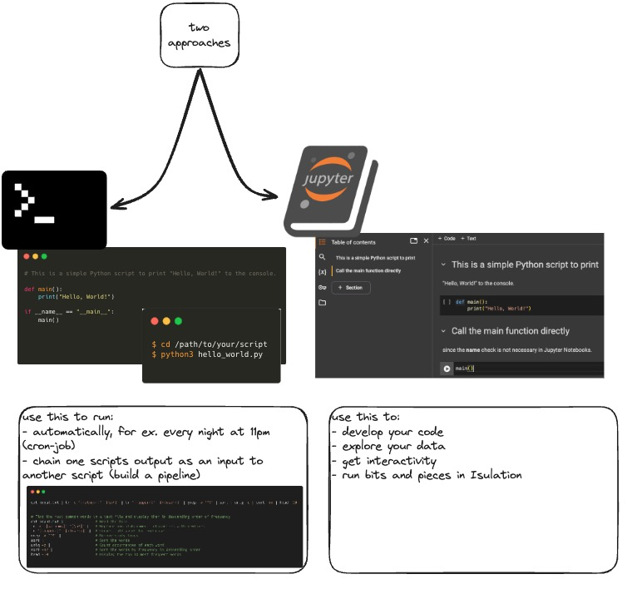
How to Python®

Slide 10
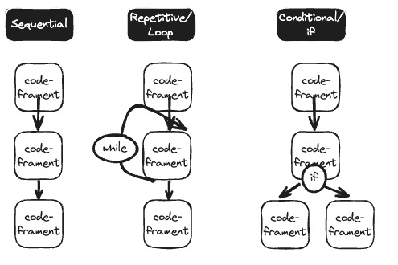
Big topics
PUT ONE OVER VISUALISATION HERE
Make consistent referencing
E.g. (🐍 1)

Slide 11
Big topics
Intro/(Python as a calculator)
Variables and file types
Lists and slicing? Do we do that so explicitly or do we use a DataFrame instead?
Loops (for/while)
Conditionals (if/else)

Slide 12
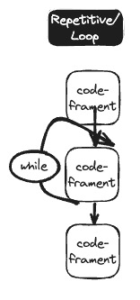
Loops
For/While
How kids learn it nowadays

Slide 13
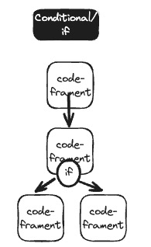
Conditions/Events/if-statements
How kids learn it nowadays

Slide 14
Over to Colab

Slide 15
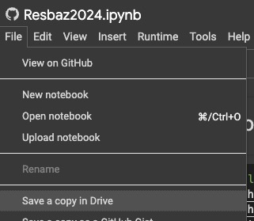
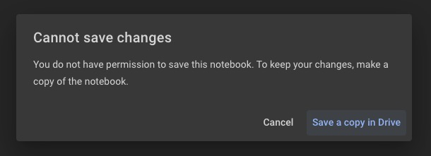
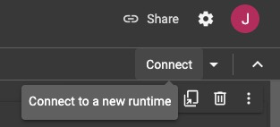
Big topics
Link

Slide 16
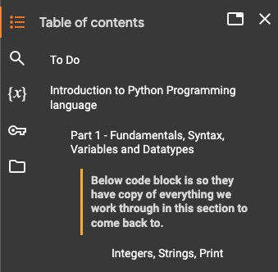
Basics
abc

Slide 17
Recap AND
Next: What if data is not just ‘one thing/value’

Slide 18
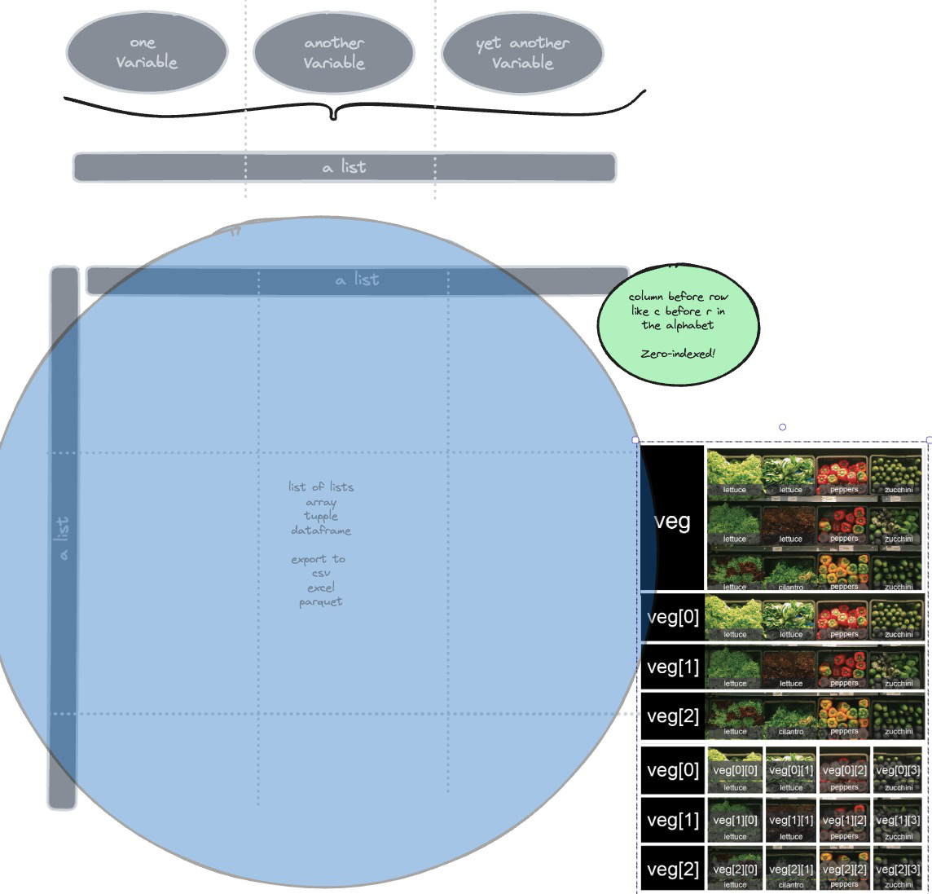
2D Data Types
## lists
## dictionaries
## (numpy arrays)
## (Pandas dataframes)

Slide 19
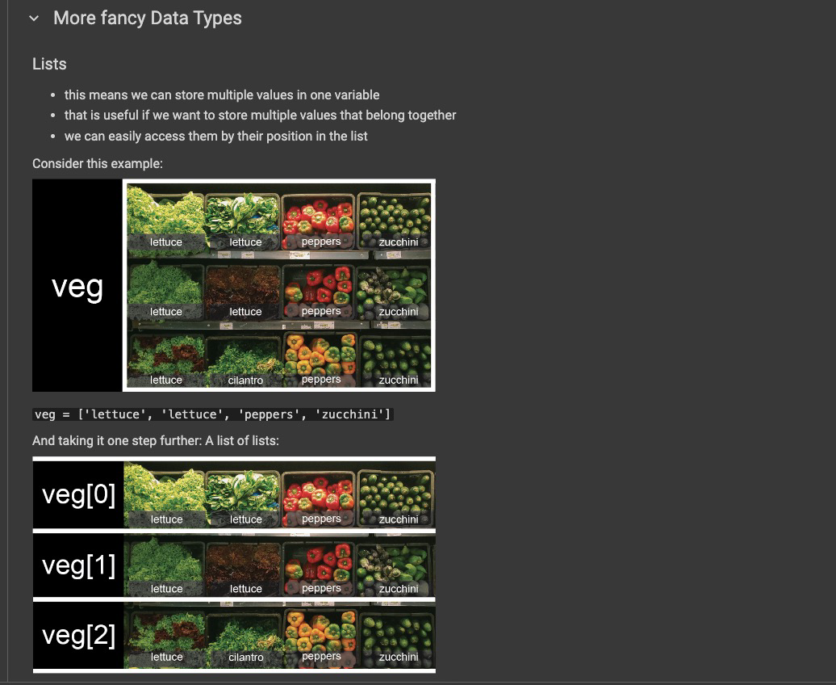
2D Data Types
## lists
## dictionaries
## (numpy arrays)
## (Pandas dataframes)

Slide 20
Recap AND
Next: Loops

Slide 21
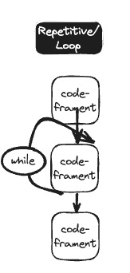
Loops – Remember the kids’ game?
## lists
## dictionaries
## (numpy arrays)
## (Pandas dataframes)

Slide 22
Recap AND
Next: Conditionals

Slide 23
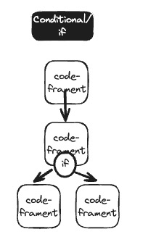
Conditionals – Remember the kids’ game?
## lists
## dictionaries
## (numpy arrays)
## (Pandas dataframes)

Slide 24
Bigger picture Recap

Slide 25
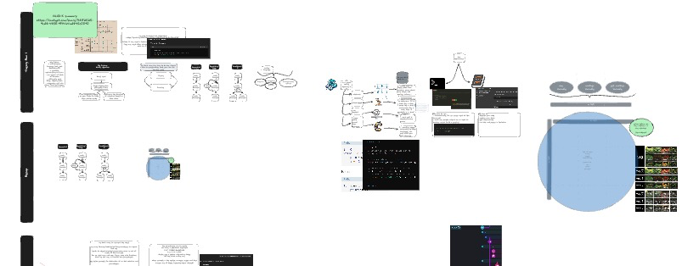
Bigger picture Recap
We established that Python is a good choice
We used it as a Calculator
We assigned values to variables
We have looped and branched out
We looked at simple scripts and different Notebook-styles
We had a glimpse at 2D (or more) data types; this topic alone could cover weeks of talking

Slide 26
Next Stop LIBRARIES

Slide 27
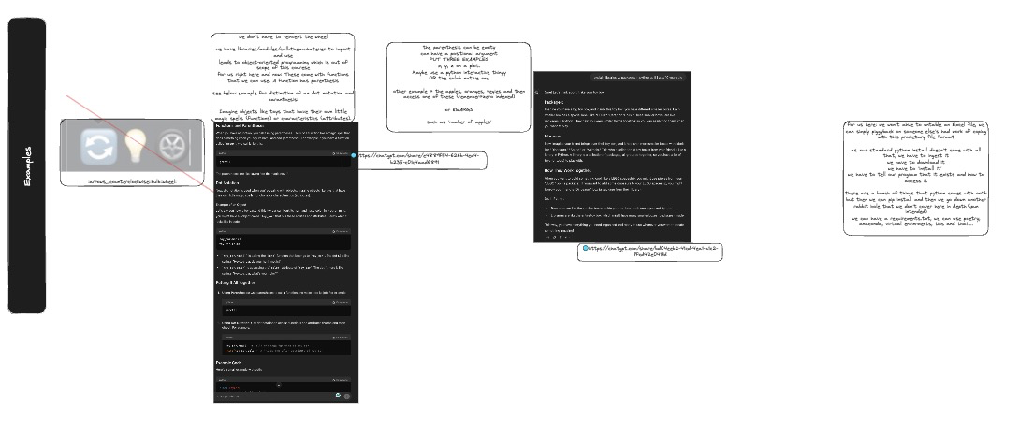
No reinventing of the wheel
Maybe mindmap what the subtopics are (version control, major/minor/bug fix) req.txt vs. poetry vs. x

Slide 28
To Do
Download the dataset

Slide 29
Ready ✅ Steady ✅ NOW: Go

Slide 30
Recap what we want to do
We have now (mostly) understood the basics
We want to import our (proprietary MS Excel) spread sheet
We want to plot it (without having to spend ages on defining setting up the plot)
Because ultimately, we want to get to know the (potential) relationship of our data

Slide 31
What we have To Do
Download the dataset
Load the relevant libraries to read Excel
Check that that all went through
Load more libraries
Plot
Be impressed 😎
Save our outputs
Inspect what happens if we were to update the underlying data
Put vis here

Slide 32
Functions

Slide 33
Functions
WRITE WHY

Slide 34
Q&A Breakout Rooms if needed

Slide 35
heading
detail

Slide 36
Links to videos/tutorials/courses

Slide 37
Links
ADD THINGS FROM WRAP UP PYTHON EMAIL HERE
Python in Excel writeup

Slide 38
Recommended next steps

Slide 39
Next steps
If you don’t continue to use it, it’s often just gone
Think of personal projects/even better: research-related
Make use of Python in your daily life
For University of Auckland
Hacky Hour for immediate questions
Next run of Python Carp
ML Carp
Talk to CeR

Slide 41
BACKUP

Slide 42
Other resources
Script to ingest csv files as Sheets in one xslx file

