Slide 1
Navigating New Zealand’s Trusted Research Protective Security Requirements
Dr Simmon Hofstetter
July 2024

Slide 2
Overview
Background
Key Aspects
Operationalisation – University of Auckland
Resources & Additional Information
Questions & Discussion (~20-30min)
Raise awareness amongst yourselves – the community

Slide 3
Foreword
Our team did not develop TR-PSR.
This presentation tends to focus on the research sector, but examples of espionage and foreign interference extend beyond.
The content can be surprising, prompting a variety of reactions…

Slide 4
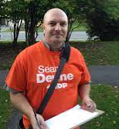
José Giammaria
Real name: Mikhail Mikushin (admitted in 2023)
Senior Russian military intelligence officer
Brazilian (passport; ~2006)
BA Political Science – Carlton University, Ottawa (2015)
MSc Strategic Studies – University of Calgary (Centre for Military, Security and Strategic Studies)
Lecturer - Arctic University of Norway – Centre for Peace Studies
Used references from Canada
Endorsed by professor in security studies (Prof Gunhild Hoogensen Gjørv)
Published in the Naval Review journal
1
"...not positively sure of his identity, but we are quite certain he is not Brazilian."
- Norwegian domestic security (2021)
https://calgary.ctvnews.ca/university-of-calgary-graduate-accused-of-espionage-1.6126308
Notes:
‘Victor Ferreira’ – Sergey Cherkasov
2022 - Dutch (AIVD)
Ireland -> USA -> Netherlands – to intern at ICC

Slide 5
Background

Slide 6
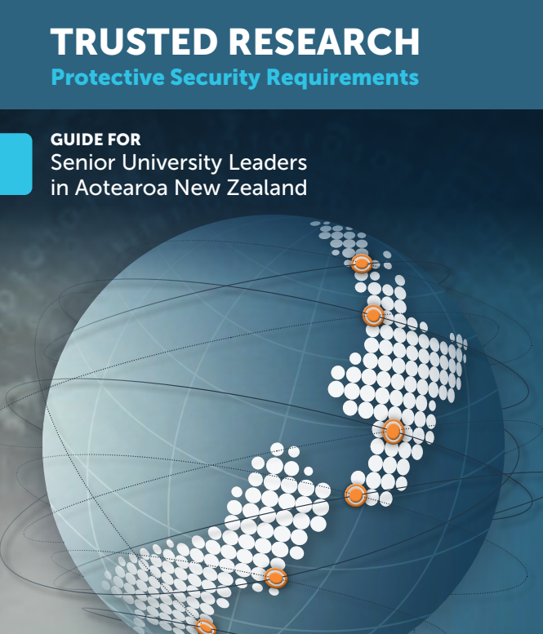
Background – TR-PSR
Trusted Research – Protective Security Requirements
National policy framework focussed on reducing risks associated with foreign interference, espionage, and export controls, particularly for sensitive research and technologies.
Protective Security Requirements (2014)
Trusted Research Guidance for Institutions and Researchers (2021)
TR-PSR Guide for Senior University Leaders (2022)
Proactive voluntary approach.

Slide 7
…
You will notice a pattern – China and Russia
This does not mean other countries are not conducting espionage and foreign interference in research.
TR-PSR is clear – implementation must not conduct racial or cultural discrimination.
Design of processes and selection of resources is crucial.

Slide 8
Scope
Industry, Academia, and Public sectors.
“…an enabling approach that includes a balanced consideration of risks and opportunities, and with processes and controls that are proportionate to the risks involved.”
→ Research and beyond…
University of Auckland defines both what it considers to be ‘sensitive’ research and acceptable associated risks.
Research Ethics
Research Integrity
Research Security

Slide 9
...
Spies
Protecting our community
Identifying and managing associated risks
Enable research while recognising that we all operate in a complex global environment
Some research will not move forward
This space will evolve as external factors evolve (legislation, geopolitics and conflict, sanctions, etc)

Slide 10
Funders Care
MBIE ‘dual-use technologies’
Te Niwha
International
Horizon Europe
Other international parties
June 2024 - US House of Representatives passed defence policy bill prohibiting DOD from funding US universities that have a research collaboration with China; Senate to take up deliberations July 2024.
Related bill referred from Congress to Committee on Armed Services – would prohibit funding for international institutions that host Confucius Institutes and remove authority to waive the prohibition.
House defense bill would block U.S. research collaborations with China | Science | AAAS

Slide 11
Implementation – where to start?
Personnel
Funding Sources
Contracting
Ideation
Procurement
Collaborations
Research
Visitors, Placements, etc
Engagements
Infrastructure
Future → prevention
Past → lingering risks
Present → current exposure

Slide 12
Key Aspects

Slide 13
What does it involve?
‘Why’…
‘When’…
3 Key Areas
Due Diligence – vetting of organisations and individuals AND their affiliations
Security Risk – physical and digital access / exploitation
Export Controls Regime – Customs and Excise Act 2018
‘Who’
‘Where and How’
‘What’
Each area comes with subjective/objective aspects.
Your institution’s senior leadership is going to need to weigh in.

Slide 14
1. Due Diligence
Assessing parties for potential to introduce risks – security, reputational, etc.
Simple but revealing questions – not unexpected
Help prevent researchers from being developed and exploited as assets and prevent access to sensitive research and infrastructure by agents.
Highly subjective area.

Slide 15
Due Diligence - Lenses
Individual
Has the individual collaborated previously with the University of Auckland?
Why does the collaborator want to work with you?
What will the collaborator receive in return for their involvement?
Within the context of the collaborator's network of affiliations, could the project support development of adverse applications?
Country
Is a collaborator linked to a country/countries which may be viewed as hostile to New Zealand, currently unstable or in conflict, or one which has different democratic and ethical values from New Zealand?
Are the collaborators' relationships with the country/countries active?
What is the nature of the relationships?

Slide 16
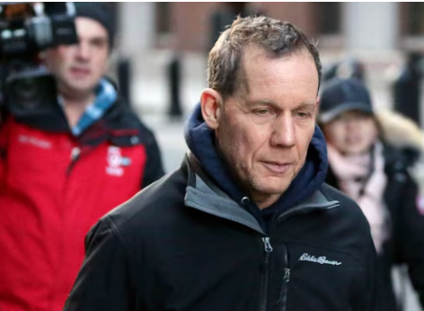
Professor Charles Lieber
Chair of Harvard Chemistry and Chemical Biology Dept
2021
Found guilty → lying to federal authorities and tax evasion
2yrs supervised release / house arrest and fined $83,600
Overall, he was facing 13 years in prison and $600k in fines.
Diagnosis of lymphoma during the period in question was taken into account.
Concealed affiliation to China’s ‘Thousand Talents Program’ (contractor) and Wuhan University of Technology (strategic scientist)
Made false statements to federal authorities, made false tax returns, did not disclose foreign bank and financial accounts (lying to federal authorities and tax evasion)
He had lied while conducting research for the DoD (lead PI heading >$15M 2008-2019) for personal financial gain.
$50k / month for 3 years, $150k living expenses, and $1.5M to establish a lab at Wuhan.
https://www.voanews.com/a/student-union_harvard-professor-arrest-highlights-intellectual-property-espionage/6183841.html
https://abcnews.go.com/US/former-harvard-professor-charles-lieber-sentenced-time-served/story?id=98871088

Slide 17
2. Security Risk – Digital & Physical
Digital security
Data Management Plan – overlapping considerations (similar to Finance)
Addresses the overarching question of how one's research space and associated physical assets are secured against exploitation by an agent:
Operating environment
Equipment
Materials
Paperwork

Slide 18
Research Security
Example
Is the operating environment secure?
Or
What measures are in place to ensure the operating environment is secure?
Is your research space a shared or dedicated space?
Do you know everyone who will have access to the space?
What access controls are in place? E.g. Card access, Two-Factor access
What monitoring/reporting is performed relating to access to the space?
Is there any physical separation or protection required between business units or within research group?

Slide 19
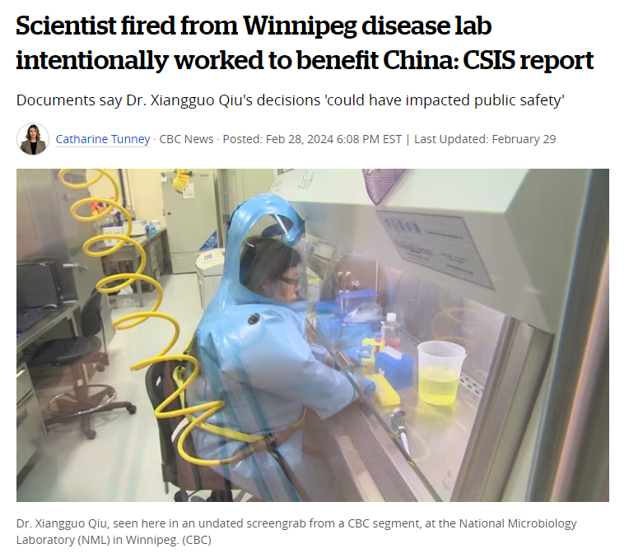
Example
Years of investigation (2019 – 2021) to reach resolution.
Shared the Ebola genetic sequence with China and toured unauthorized personnel with ties to PRC political apparatus.
Iterative processes should ideally be embedded within organisations – Due Diligence is not something to be conducted once and never again.
Naivety - real or otherwise…
https://www.cbc.ca/news/politics/winnipeg-lab-firing-documents-released-china-1.7128865

Slide 20
3. Export Controls Regime
Currently governed by Customs and Excise Act 2018
New standalone legislation pending
Controls:
strategic goods (i.e. explicitly listed on the NZSGL)
catch-all goods (i.e., not listed, but has a military end use)
controlled chemicals
Excludes:
fundamental/basic research
information already in public domain
minimum information for patents
(most) medical equipment/products.

Slide 21
Export Controls Regime
Exports include:
electronic transfers of research/technical data
physical transfers of components, prototypes or physical ‘goods’
travelling overseas with research data
providing consulting or advisory services to overseas clients
Future legislation likely to include:
in-country deemed exports (i.e., to foreign nationals in NZ)
more controls on intangible transfers (e.g., cloud storage)
AUKUS Pillar 2 ‘wild card’

Slide 22
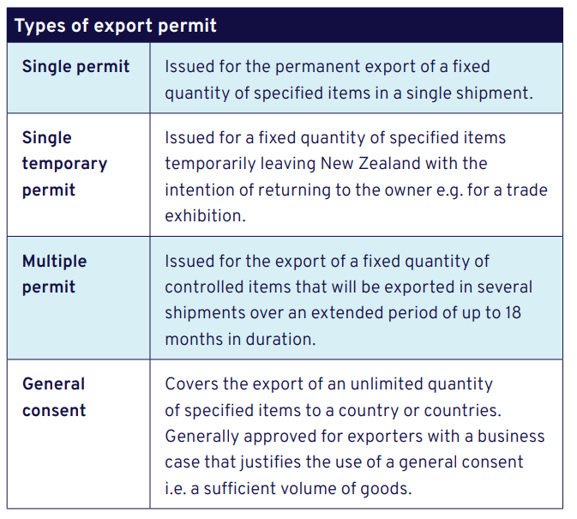
Export Controls - Types of Permits
Effort vs reward

Slide 23
Operationalisation

Slide 24
Implementation – where to start?
Personnel
Funding Sources
Contracting
Ideation
Procurement
Collaborations
Research
Visitors, Placements, etc
Engagements
Infrastructure
Future → prevention
Past → lingering risks
Present → current exposure

Slide 25
Where do we want to end up?
What does a mature research security framework look like?
Adaptive processes that can be ramped up or down (geopolitics).
Minimal administrative burden – leveraging existing systems (data retrieval).
Responsive – near real-time reporting capabilities.
A mature community of researchers and supports that instinctively apply principles of research security.
Environment of trust.
Your personnel…

Slide 26
Overview
‘Get comfortable being uncomfortable.’
High-trust models…
Initiation & consultation – set up Project Team, Reference Group, and Academic Co-Leads
Identified priority area – research funding
Set parameters – defined ‘risk’ in alignment with external definitions (‘pure basic research’ ANZSRC) and ‘enterprise’ risk framework.
Confirm and proceed – endorsement of scope by University governance
→ Throughout, we have woven elements from TR-PSR documentation but with revised terminology
Community discussions indicated this was necessary.
E.g., 3 key areas (Due Diligence, etc) framed as a single research security assessment.

Slide 27
Pre-award
Post-award
Online Training Module(s)
Proposal Development
Proposal Submission
(entry to UoA system)
Research underway
Research Completed
Guidelines
Supplementary Resources
Screening Questionnaire
Research Risk Assessment
Risk Management
(ongoing)
Due Diligence
Templates
Export Controls
Escalation & Decision
Research Security
Single Source
Health & Safety
Human Health Research
Research Hazards
Research Data Management

Slide 28
Operationalisation
Dedicated resource recommended
Export Controls Officer
Research Risk and Compliance Manager
People are a vulnerability and an asset
Process and organisational culture matter
Existing areas of best practice (financial fraud prevention) overlap with research security implementation
Resource identification is a serious challenge.

Slide 29
Resource Breadth
Balance the reliability of the resource against subjectivity of the area in question.
E.g., Due Diligence as a ‘values-based’ exercise vs overlapping areas of practice (financial, etc).
Amnesty International
Academic Freedom Index
Australia’s Chinese Defence Universities Tracker
United Nations resources – who is on Security Council?
Financial Action Task Force
OECD
Wassenaar Arrangement members
Etc…

Slide 30
Current and Future Work
Pre- and post-award processes for all research proposals.
Relationship building with Ministries and other institutions
Share information, expertise, and ways of working.
General Consent permits and Export Controls Compliance Plans
Standard provisions in all research and consulting contracts
Travel Policy
Future – visitor policy
Vetting of academic and professional staff
Vetting of international students
Co-locator considerations
Etc…
Exploring potential tools for use.

Slide 31
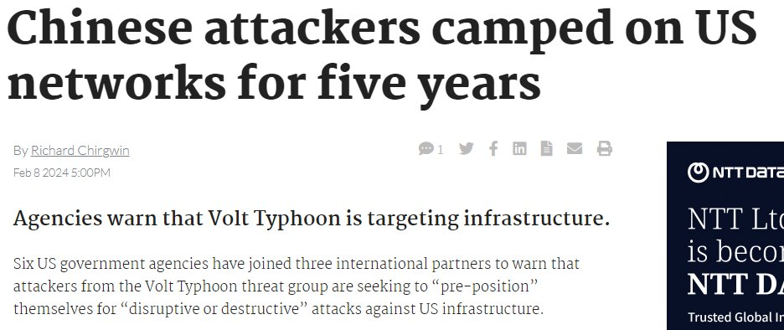

Slide 32
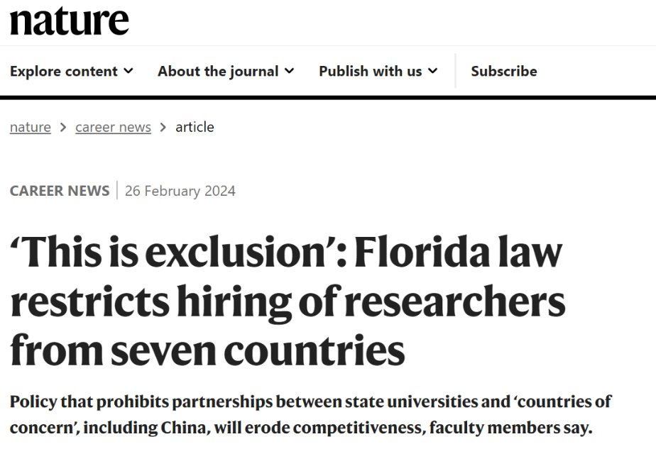
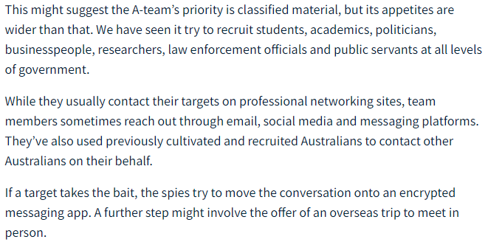
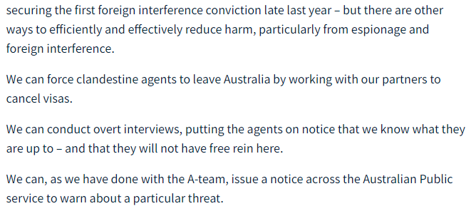

Slide 33
Resources & Additional Information

Slide 34
Resources
PSR website
TR-PSR guidance for Universities
TR-PSR Due Diligence – dedicated document
Export Controls (MFAT site)
UNZ Training Module (Universities) – second module in development
Speak with your host institution team

Slide 35
Questions & Discussion

