Slide 1

Data Management Planning
1 July 2026
Tom Saunders, Centre for eResearch

Slide 2
Overview of this session
What is a data management plan (DMP) and why should you create one?
What are the common sections and content of a DMP?
(Plus, a few best practices to consider)
How can a DMP support your research practices across the research data lifecycle?

Slide 3

Activities
Challenges
Introductions
Introductions
What is your current role or career stage?
What research discipline best describes your research area?

Slide 4
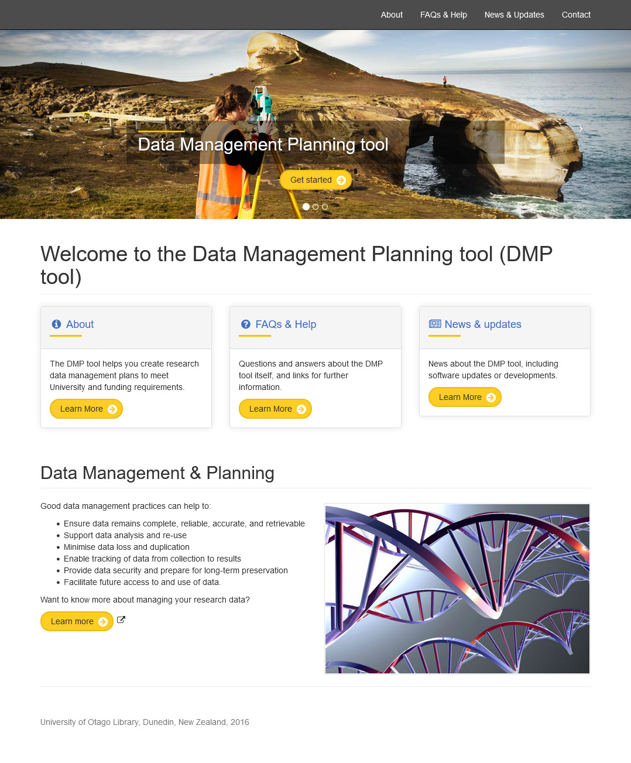
What is a data management plan?
A Data Management Plan (DMP) helps researchers to consider and document decisions about research data.
Project specific
May be required, always recommended
Prompts conversations, captures decisions, clarifies roles and responsibilities and helps researchers to align with policies and processes
Checklist for a Data Management Plan from the Digital Curation Centre
Notes:
A DMP describes how research data will be managed throughout your research project. It can begin as a basic plan, and further information can be added as the project progresses.
A DMP is required at the University of Auckland for projects involving sensitive or restricted research data, but it is recommended for all.
It should cover:
Project information including the purpose of the research, people involved and their roles and responsibilities.
A description of the data that will be created or collected and in what format
How sensitive data will be treated, including ethical and legal considerations and compliance
Where the data will be stored and how it will be curated (organisation, formatting and documentation)
Who will own and have access to the data (alternatively, who will enable kaitiakitanga and enable stewardship/guardianship of the data)
How will the data be preserved and shared
Who is responsible for data management throughout the project and beyond
A DMP is important because it helps you to consider, document and establish:
Metadata standards which will be used for data formats.
Classification and sensitivity of your research data.
Storage and backup procedures and provisions.
Future access to the research data for sharing and/or reuse.
Retention and disposal procedures and provisions.
Ownership and protection of intellectual property.
Documentation describing all of the above.
A DMP is:
A record that describes the data you expect to collect and how you intend to manage, archive and share that data
A roadmap for how data will be managed and shared throughout the research data lifecycle
A description of how you will implement data management practices into your research process
A living document that you can update if there are changes in your research project
A tool for collaboration that establishes data management norms and identifies resources or skills needed to implement the plan

Slide 5
Benefits of data management planning
Compliance & Good Research Practice
Protect
Connect
Helps organise and store data securely to reduce the risk of data loss or unauthorised use of project data.
Keeps project information in one place where it can be shared & discussed with project team members, reducing errors and uncertainty.

Slide 6
Structure and content
Notes:
In this section, we will consider:
The tools and templates available to create DMPs
The information that should be included in a DMP (including a few best practices to consider)

Slide 7
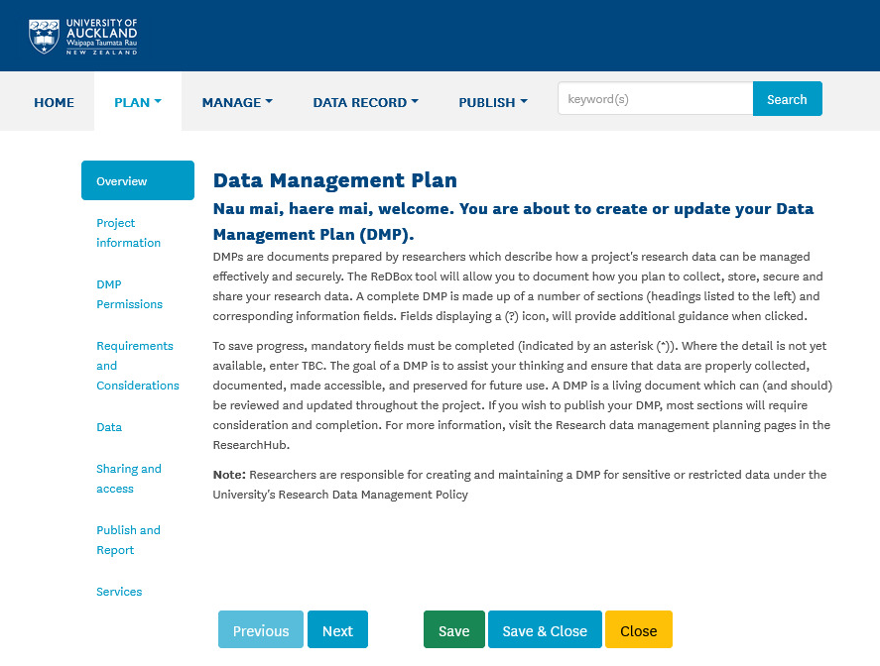





DMP tools and templates
Online DMP tools
Bespoke / configured DMP tools
DMP templates

Slide 8
Conversations
Zoom poll…
What does your organisation
provide to create DMPs?
Notes:
Zoom poll
What are you currently using to document your research data management plan?
DMPonline (https://dmponline.dcc.ac.uk/)
Paper/text document (e.g. a word template)
DMPTool (https://dmptool.org/)
Institutional DMP tool (e.g., https://dmp.auckland.ac.nz)
Other
None
Someone else in the research team handles that

Slide 9
Project information
Next section
Requirements
Purpose of the research
Roles and responsibilities
Funding
A good DMP…
Contains the minimal information required to identify the project.
Allows for information to be pulled through, where possible, to prevent double entry.
Notes:
Project information
Project information including the purpose of the research, people involved and their roles and responsibilities.
Who is responsible for data management throughout the project and beyond
A good DMP
Contains the minimal information required to identify the project, the project team and any project funding
Clearly outlines the roles and responsibilities for data management/stewardship, naming responsible individual(s) where possible.
Clearly indicates who is responsible for day-to-day implementation and adjustments to the DMP.
Explains, for collaborative projects, the co-ordination of data management responsibilities across sites.

Slide 10
Requirements
Next section
Considerations
Data policies applying to the project (include institutional, funder, government, publisher and other policies)
Identifies classification and sensitivity of research data
Make sure you know about…
Institutional policies (examples)
Research data management policy
Research integrity policy
Intellectual property policy
Privacy policy
IT security & generative AI guidance
Other policies
MBIE Open Research policy
Trusted Research – Protective Security Requirements
Research Charter for Aotearoa New Zealand
Notes:
Think of the requirements section as acknowledging the research environment in which this project is being conducted, including the data policies that apply to the conduct of this research, and the research data security classification (and research security checks) that apply.
Requirements
Institutional/organisational and other data policies
Identifies the sensitivity of the data (or data classification)
A good DMP:
Identifies one or more research data security classifications applying to the project
Identifies institutional policies applying to the conduct of the project (e.g., at University of Auckland: RDM policy, Research Integrity policy, IP policy, privacy policy, IT security, generative AI).

Slide 11
Data
Next section
Sharing and Access
Describes the data that will be created or collected and in what format.
Where the data will be stored and how it will be curated (organisation, formatting and documentation)
Sections for data source considerations, metadata and documentation, storage, software and equipment.
Notes:
The Data section describes the data to be created/collected, consideration of the data source, metadata and documentation, data storage, and software and equipment required for the project.
Data includes
What data is being collected?
How will it be organised?
Where will it be stored?
What equipment and software are required?
A good DMP…
Description of data
Clearly describes or lists what data types will be generated (for example, numeric, text, audio, or video) and their associated data formats, including, if needed, data conversion strategies.
Gives clear details of where the existing data come from and how new data will be collected or produced. Clearly explains methods used.
Explains clearly, if applicable, why new data must be collected, instead of re-using existing data.
Clearly describes the approach taken to ensure and document quality control in the collection of data during the project.
Explains why certain formats have been chosen and indicates if they are in open and standard format. If a proprietary format is used, it explains why.
Clearly describes or lists what non-digital data types will be generated (including tissue samples, if appropriate).
Reuse of existing data. Explains how existing data to be re-used will be accessed. Indicates, if applicable, whether there are any restrictions on the re-use of third-party data. Explains how data provenance will be documented.
Metadata and documentation
Clearly outlines the metadata that will accompany the data
Clearly outlines the documentation needed to enable data re-use, stating where the information will be recorded (for example, a database with links to each item, a ‘readme’ text file, file headers, code books, or lab notebooks).
Indicates how the data will be organised during the project (for example, naming conventions, version control strategy and folder structures).
Data storage
States the location where the data and backups will be stored during the project.
Software and equipment required for collection and analyses
Gives clear details of software or equipment used to create and/or collect new data, and to manipulate or analyse the data.
Describes additional compute resources or high-performance computing resources required to analyse the data.
Questions to consider:
How will the data be collected/created?
What standards or methodologies will you use for data collection?
What quality assurance processes will you adopt?
Do your chosen formats and software enable sharing and long-term access to the data?
Clearly describes the approach taken to ensure and document quality control in the collection of data during the project.
Explains why certain formats have been chosen and indicates if they are in open and standard format. If a proprietary format is used, it explains why.
Non-digital data
What non-digital data or physical artefacts will be created or collected during your research (e.g., tissue samples in clinical trials)

Slide 12


Data creation
Example
Pilot study
Data / Creation and collection / Data creation/collection
Data creation/collection
Identifiable data:
Name and contact details of participants (entered into REDCap for duration of project)
Interview audio files, containing potentially identifiable information (.mp3, WAV) ~30-90 mins per session; ~10-100 MB per file depending on quality = 1-5 GB for 20-30 sessions.
De-identified data:
Online survey data (raw + processed + final dataset)
  Raw data will be collected using REDCap. At the end of data collection, a complete file from REDCap will be downloaded and saved as an ‘original’ and unchanged version of the data as a .csv file. A copy of the data will be saved and used for statistical analyses.
Interview transcripts x40 (docx, txt, pdf) ~5000-10,000 words per transcript = ~ 2-5 MB
Coding and thematic analysis files (NVivo - .nvp or Excel - .xlsx) <100MB total
App usage data obtained from external app vendor (raw + processed; .csv)
Participant metadata, including demographic info, interview date (excel; .csv) = <1MB
Notes:
Data creation/collection
Clearly describes or lists what data types will be generated (for example, numeric, text, audio, or video) and their associated data formats, including, if needed, data conversion strategies.
Gives clear details of where the existing data come from and how new data will be collected or produced. It clearly explains the methods used.
Explains clearly, if applicable, why new data must be collected instead of re-using existing data.
Clearly describes the approach taken to ensure and document quality control in the collection of data during the project.
Explains why certain formats have been chosen and indicates if they are in open and standard format. If a proprietary format is used, it explains why.
Non-digital data/physical artefacts
Clearly describes or lists what non-digital data types will be generated (including tissue samples, if appropriate).
---
Examples are provided to indicate length and scope. They do not represent advice on approved methods for all research projects.
Please consider your own research when developing your research data management plan.

Slide 13
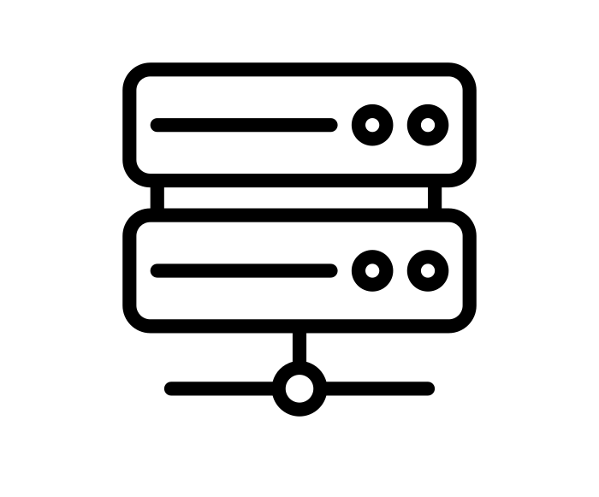
Digital research data storage
When selecting data storage:
Are you collecting personal (identifiable) data?
Who needs access?
How much storage space do you need?
How will the data be protected against loss?
How will you ensure the data is secure?
What does your funder and/or organisation require?
Be aware of the 3-2-1 rule for backups
At least 3 copies | Using at least 2 different storage media | At least 1 copy offsite
Notes:
Appropriate research data storage is essential to ensure that data remains secure and protected against loss and unauthorised use.
Type of data
Are you collecting personal data?
Does the data in any other way require special protection?
Who needs access?
Does the project require granular access restrictions?
Where do project team members need to access the data?
Things to think about:
What data are being collected/gathered?
Are you working with sensitive data?
Where are you required to, or have agreed to, store data?
Who needs access, and where are they when they access?
Does the project need granular access restrictions?
What processing or analysis will be needed?
What is available?

Slide 14
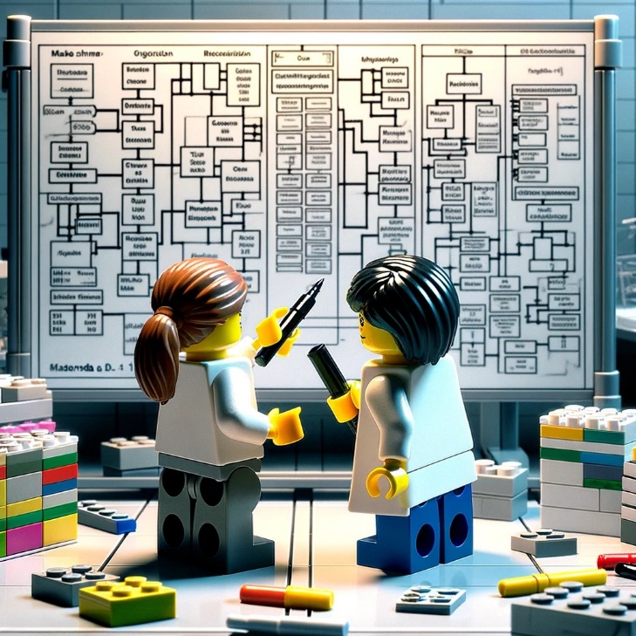
What metadata do you need?
Metadata is a list of information you expect will be needed for the data to be read and interpreted in the future.
Ensures data can be shared, discovered and reused
Facilitates reproducibility and scientific integrity
Metadata across the research data lifecycle:
Who created the data?
What does the data file contain?
When were the data created?
Where were the data created?
Why were the data created?
How were the data created?
Research data / Organising and describing research data / Research metadata
Notes:
Ensuring research data is accompanied by appropriate documentation and metadata will help you and your collaborators to understand what you did and why. This supports the reproducibility of findings and is good research practice.
Metadata across the research data lifecycle
Who created the data? (citation and information on data curators, data collectors, sponsors and contributors)
What does the data file contain? (Data format, file type, file structure, variable descriptions, missing data, weighting variables, software and keywords)
When were the data created? (Dates of fieldwork, time period covered, time dimension)
Where were the data created? (Spatial units and geographical coverage)
Why were the data created? (Background to creation and planned use)
How were the data created? (Methodology of data collection, sampling and processing, data access information)

Slide 15
Considerations
Next section
Data
Requirements and Considerations / Considerations / …
Identifies legal, ethical, data sovereignty, IP and other considerations for the research data.
Ethics
  Consent, protection of privacy, access controls
Data sovereignty
Plans to consult and enable rights of stakeholders and indigenous peoples involved in the research
Contracts and copyright.
Notes:
Considerations
How sensitive data will be treated, including ethical and legal considerations and compliance
A good DMP:
Identifies legal, ethical, data sovereignty, IP and other considerations for the research data and briefly describes how each consideration that has been identified will be addressed.
Indicates whether personal information will be collected/used as part of the project, and if applicable, how compliance with applicable policies and legislation (including NZ’s Privacy Act 2020) will be ensured (for example, by gaining informed consent, considering de-identification or anonymisation, etc)
Provides details of what ethical issues have been considered that may affect data storage, transfer, use, sharing and/or preservation and demonstrates that adequate measures are in place to manage ethical requirements.
Identifies stakeholders and rights holders to the data and briefly describes plans to consult with these groups (including the rights of indigenous peoples involved in the research)
Identifies ownership of copyright and IP related to this project.

Slide 16
Ethical considerations
Requirements and Considerations / Ethics / Ethical considerations and management of data
What are the ethical considerations surrounding the research data?
Privacy and confidentiality
  Does the project involve the collection of personal information (especially health information)?
  What processes will you use to de-identify data to ensure confidentiality? What is the risk of re-identification?
Access controls, including storage and transfer of data
  Where will data be stored? What software or systems will be used to manage or analyse the data? Who will have access to the data, and how will access be controlled?
Data deletion, archive and/or sharing for reuse
  What are the conditions of data sharing, including applying an appropriate license? Have you gained consent for data preservation and sharing? How and when will the data be archived and/or deleted?
Research ethics
Notes:
Consider all the ethical issues that may affect your project.
How will you protect participant identity?
What processes will you use to de-identify or anonymise data to ensure confidentiality and protection of privacy?
How will you securely store and transfer sensitive data?
What processes will you use to obtain consent for data sharing or reuse/optional secondary uses?
A good DMP
Clearly indicates if personal data will be collected or used as part of the project and, if applicable, how compliance with applicable policies and legislation will be ensured (for example, by gaining informed consent, considering de-identification or anonymisation, etc.)
Provides details of what ethical issues have been considered that may affect data storage, transfer, use, sharing and/or preservation, and demonstrates that adequate measures are in place to manage ethical requirements.
Informed consent, including provision for data sharing
Protection of participant identity by de-identifying data, and assessing the risk of re-identification where needed
Access controls, including storage and transfer of data
Conditions of data sharing, including applying an appropriate license.

Slide 17
Sharing and Access
Next section
Publish and Report
Who will own and have access to the data.
How will the data will preserved and shared for reproducibility and/or reuse.
Retention and disposal procedures and provisions.
Notes:
Sharing and Access
Who will own and have access to the data during and after the study (alternatively, who will enable kaitiakitanga and enable stewardship/guardianship of the data)?
How will the data be preserved and shared for reproducibility and/or reuse?
Future access to the research data for sharing and/or reuse.
Retention and disposal procedures and provisions.
A good DMP…
Identifies who will have the rights to control access to the data.
Identifies who will be responsible for ensuring good records management practices are followed, managing data and information – including metadata, and managing any escalated risks.
Clearly explains who will have access to the data during the project and what access conditions will apply.
Clearly describes whether the data will be shared after the project.
Clearly explains, if applicable, why data sharing is limited or not possible, and who can access to data under what conditions (for example, only members of certain communities or via a data sharing agreement).
Indicates how long the data will be retained.
Indicates what data must be retained or destroyed for contractual, legal, or regulatory purposes.
Describes how it will be decided what data to keep.
Explain the foreseeable research uses (and/or users) for the data.
Provides details of what data collected or created in the project will be preserved in the long term and clearly indicates for how long. This should align with funder, institutional, or national policies and/or legislation, or community standards.

Slide 18
Archive and retention
When you have finished working with your research data, you should…
Evaluate your digital research files to identify data from debris
Ensure that data is stored safely, in a suitable file format, and accompanied by adequate and self-explanatory documentation (e.g., README)
Digitise non-digital research data whenever possible
(Guidance https://www.openaire.eu/non-digital-data-guide)
Research data retention
What is the minimum retention period? (for transparency and reproducibility, compliance with regulations and ethical requirements, verification of research findings)
During this period, the data should be archived on secure organizational storage and non-digital data held locally.
Notes:
Research data archiving is about storing and preserving research data for the long term.
Before you archive, you need to check your files and decide what needs to be kept to reproduce the research findings. Data and files (e.g., intermediate files) that can be easily recreated are called research debris and can be deleted.
You may also want to consider data that should be returned at this stage.
When you archive your data, you make sure you can read and access the data later on. You can then also allow access to others for verification purposes when such a request arrives. In all cases, you should store your data safely, in a suitable file format, with adequate documentation.

Slide 19
Publish and Report
Describes how the data and/or metadata will be made discoverable and shared.
Provides name of data repository, data catalogue or registry where data and/or metadata will or could be shared.
States the license under which data may be publicly shared.
Notes:
Publish and Report
Describes how data and/or metadata will be made discoverable and shared (enabling FAIR data principles)
Provides the name of a data repository, data catalogue or registry where data and/or metadata will or could be shared
License under which data may be publicly shared
A good DMP…
Clearly describes how the data and/or metadata will be made discoverable and shared.
Specifies when data will be shared.
Explains, where possible, what actions will be taken to overcome or to minimise data sharing restrictions.
Includes the name of the repository, data catalogue, or registry where data and/or metadata will or could be shared.
Provides information, if relevant, on any protocol to access the data (for example, if there is a data request procedure).
States the license under which data will be publicly shared.
Specifies how the data can be re-used in other contexts.

Slide 20
Am I enabling FAIR data principles?
F
A
I
R
Findable
Accessible
(others know how to access)
Interoperable
Reusable
Metadata are external facing, human and machine readable
Metadata is with data and specific to the disciplinen
Research data / Organising and describing research data / FAIR principles for research data
Notes:
The FAIR data principles have been designed to maximise the integrity and impact of research data by supporting discovery and reuse both by humans and machines.
Making research data that you work with more FAIR can:
Increase visibility and impact of yourself and your work
Maximise the potential from your datasets
Improve the reproducibility of your research.
Strategies to implement FAIR
Findable
Describe your research data using metadata
Give your research data a unique persistent identifier (DOI)
Accessible
Register your research data or metadata record online
Describe how access can be requested
Interoperable
Use open non-proprietary file formats to ensure that others can reuse and reproduce your research findings
Use a common metadata schema or data description that can enable data exchange
Reusable
Apply a license and explain how the data can be reused
Ensure that it is ethnically and legally appropriate to share the data, including participant consent to make the data available.

Slide 21
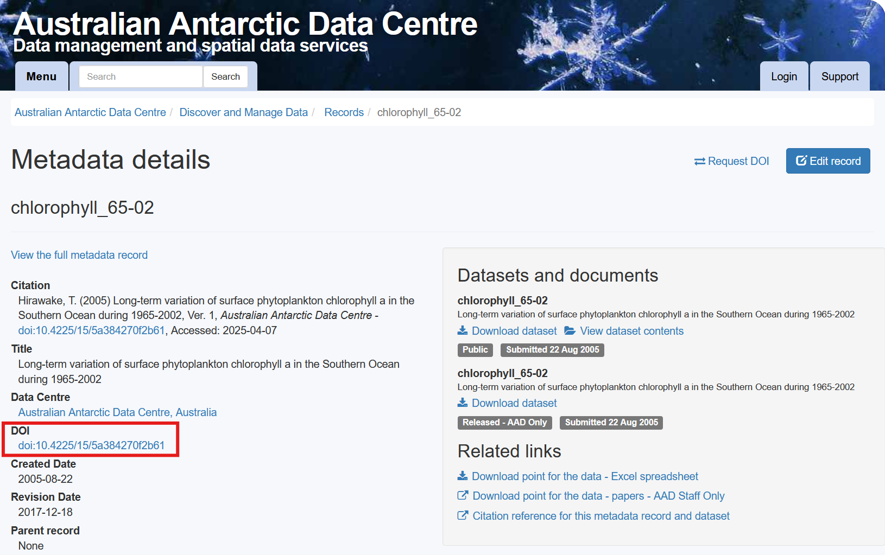
Example
Enabling FAIR
Unique persistent identifier (DOI)
= Findable
Notes:
This is a metadata record for a dataset held with the Australian Antarctic Data Centre. All Antarctic datasets funded by Australian government are added to this repository (or people don’t get funded again!)
Metadata example: https://data.aad.gov.au/metadata/records/chlorophyll_65-02
Publishing the metadata record in a data repository registers the record online and enables online discovery - enables Findable and Accessible.
Giving the research data a unique persistent identifier (DOI) enables Findable

Slide 22
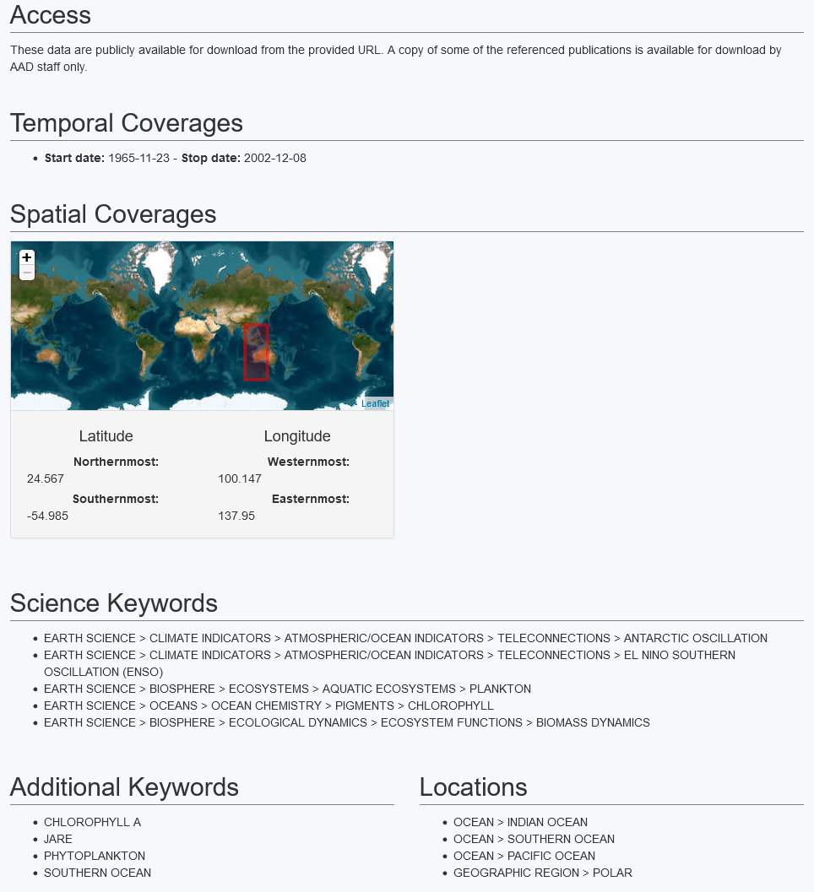
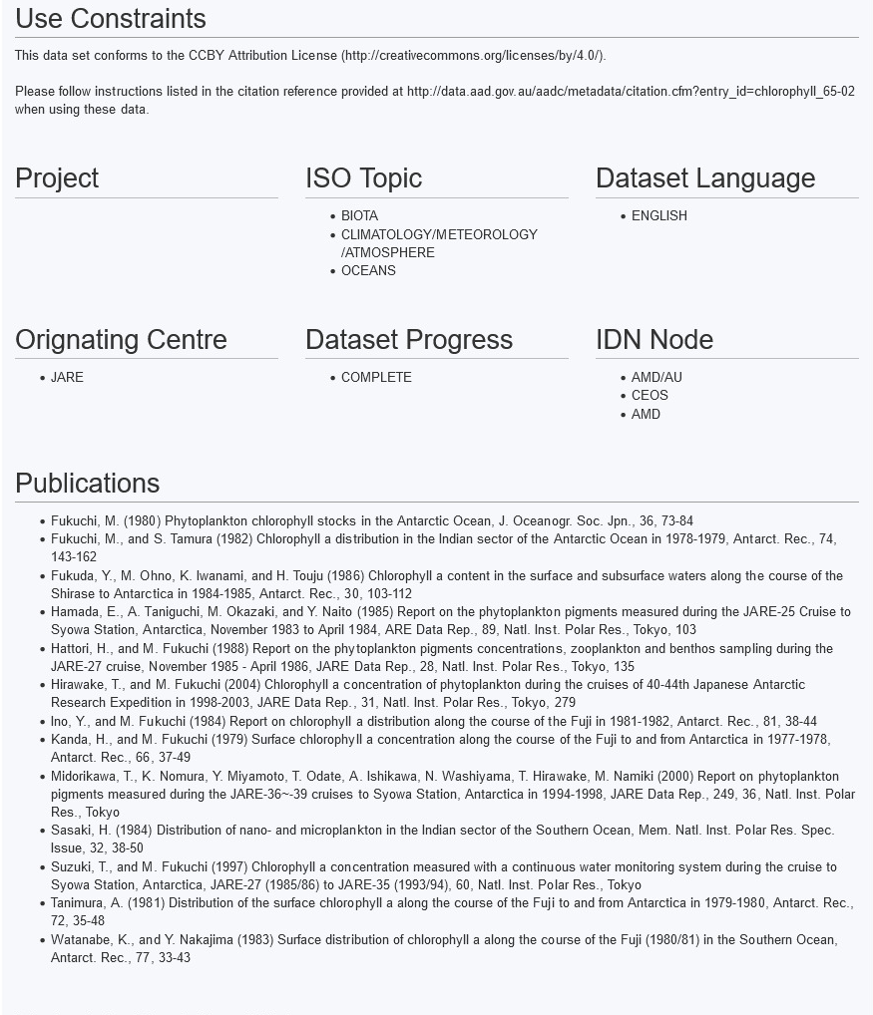
Example
Enabling FAIR
Describe access conditions
= Accessible
Notes:
Describing how access can be requested enables Accessible
Describing the data using metadata and using a common metadata schema enables FAIR

Slide 23
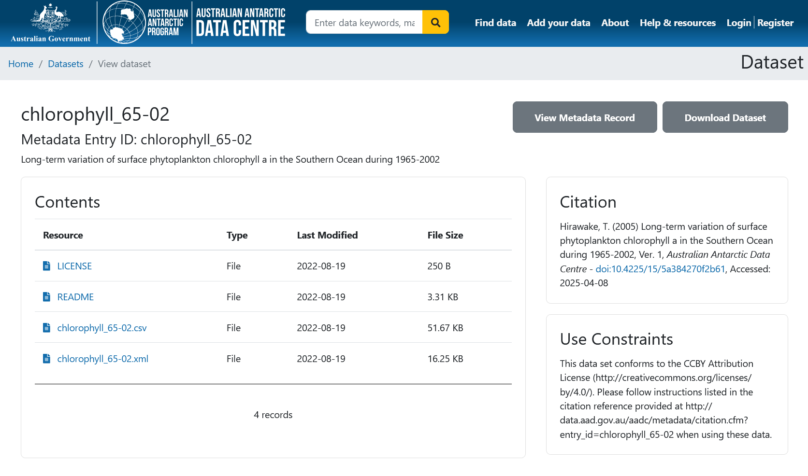
Example
Enabling FAIR
Apply a license
= Reusable
Metadata is with data
= Interoperable
Use open file formats,
= Interoperable
Notes:
Selecting this dataset to download leads you here - 4 files.
Applying and sharing a license describes how the dataset can be used/reused – enables Reusable
Including a README file includes metadata that enables understanding of what was done and how, abbreviations, data structure etc. – enables Interoperable
Using open no-proprietary file formats to ensure that others can reuse the data – enables Interoperable
(In this case, 2 sets of the same dataset but in two different formats - csv and xml to suit different users and purposes.)

Slide 24
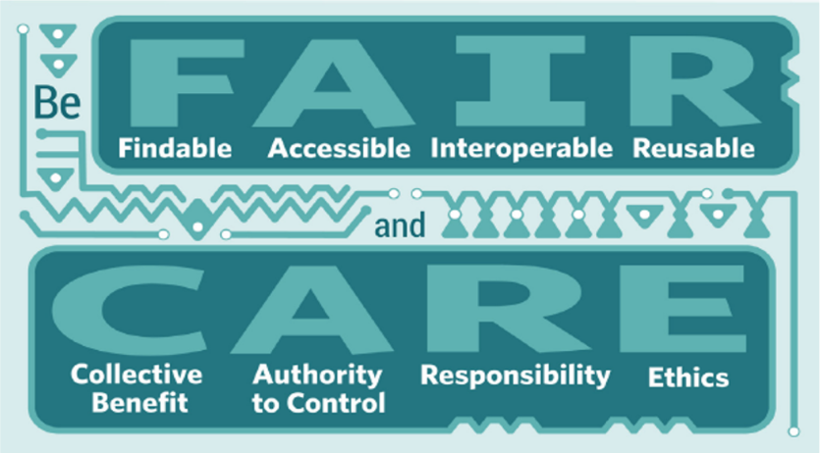
Balancing FAIR and CARE
Publish a descriptive or metadata-only record
Create a mediated access process
Use a data sharing agreement
Produce a data availability statement linking data DOI to research outputs
Notes:
24

Slide 25
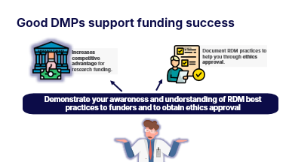
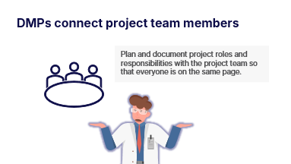
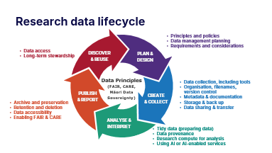
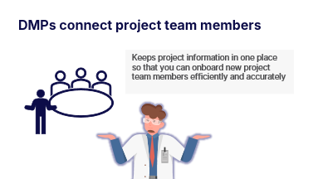
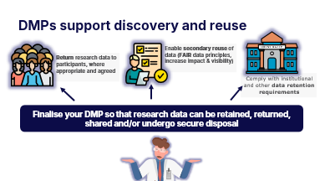




DMP across the research data lifecycle
“DMPing” is an ongoing active process across the RDM lifecycle.
Here are four times having a good quality DMP can save you time and energy.

Slide 26
Research data lifecycle
  Principles and policies
  Data management planning
  Requirements and considerations
  Data access
  Long-term stewardship
DISCOVER
& REUSE
PLAN &
DESIGN
Data Principles
(FAIR, CARE,
Māori Data
Sovereignty)
  Data collection, including tools
  Organisation, filenames,
  version control
  Metadata & documentation
  Storage & back up
  Data sharing & transfer
PUBLISH
& REPORT
CREATE
& COLLECT
  Archive and preservation
  Retention and deletion
  Data accessibility
  Enabling FAIR & CARE
ANALYSE & INTERPRET
  Tidy data (preparing data)
  Data provenance
  Research compute for analysis
  Using AI or AI-enabled services
Notes:
What are research data?
The evidence that underpins the answer to a research question and can be used to validate findings.
The research data lifecycle includes everything from planning how data will be collected, to publication, to long term data preservation, to possible reuses of data.
Although the research processes may vary across disciplines and research domains, there are some common elements to discuss across the five stages.

Slide 27
Review and update the DMP
DISCOVER & REUSE
PLAN &
DESIGN
CREATE &
COLLECT
ANALYSE &
INTERPRET
PUBLISH &
REPORT
  DEVELOP
  REVISE
  UPDATE
  FINALISE
  Understand legal & ethical requirements & data policies
  Describe data to be created/collected
  Plan metadata & documentation
  Establish security/access:
      Project team & roles
    Ownership & custodianship
    Identify storage solutions
  Update methods, processes & systems to collect or create data
  Maintain data provenance & metadata
  Implement storage ethics, privacy & security considerations
  Refine & extend metadata
  Data access
  (secure transfer)
  Document data analysis approaches
  Archive & disseminate data and/or metadata
  Finalise datasets accessibility rules
  Shared (published) data is licensed
  Data custodianship in place
Notes:
We have combined common elements across the research data lifecycle with international best practices to set out guidance for maintaining a DMP across a research project.
This is particularly designed for doctoral candidates and their supervisors.

Slide 28

Good DMPs support funding success
RESEARCH FUNDER
Increases competitive advantage for research funding.
ETHICS
Document RDM practices to help you through ethics approval.
Demonstrate your awareness and understanding of RDM best practices to funders and to obtain ethics approval
Notes:
Demonstrate your awareness and understanding of RDM best practices to funders and to obtain ethics approval

Slide 29
DMPs connect project team members
Plan and document project roles and responsibilities with the project team so that everyone is on the same page.
Notes:
Plan and document project roles and responsibilities with your project team so everyone is on the same page.

Slide 30
DMPs connect project team members
Keeps project information in one place so that you can onboard new project team members efficiently and accurately
Notes:
Keeps project information in one place so that you can onboard new project team members efficiently and accurately

Slide 31
DMPs support discovery and reuse
Enable secondary reuse of data (FAIR data principles, increase impact & visibility)
Return research data to participants, where appropriate and agreed
Comply with institutional and other data retention requirements
Finalise your DMP so that research data can be retained, returned, shared and/or undergo secure disposal
Notes:
Update your DMP regularly so that the research data can be retained, returned, shared and/or or disposed

Slide 32
Pātai / kōrero about DMPs
Some questions to consider and discuss

Slide 33
Conversations
Zoom poll…
Have you completed a data management plan (DMP) before?
In what situations did you find a research DMP most helpful?
At the start of the project to plan research data management
To obtain ethics approval
To discuss plans and responsibilities with the project team
During the study when I needed to refer to decisions made, metadata or data organisation or other details
At the end of the study to plan for post-study retention requirements and/or sharing for reuse

Slide 34
Conversations
The best strategy to support me to create and maintain a research DMP is to:
Have lots of training available
Train and support local data stewards (or advisors) to individually support researchers
Provide lots of self-directed resources
Make it easy – integrate systems and workflows better so that they share information (e.g., title, abstract, project team members, funding)
Zoom poll…
Rank the strategies from most important > least important
In the Zoom chat…
Share any comments/thoughts or raise your hand to speak

Slide 35
Conversations
DMPs should be mandated (compulsory) for all research projects…
Zoom poll…
Choose whether you agree or disagree with this statement
In the Zoom chat…
Share any comments/thoughts or raise your hand to speak

Slide 36
Conversations
DMPs should be a compulsory provisional/first year goal for all doctoral students…
Zoom poll…
Choose whether you agree or disagree with this statement
In the Zoom chat…
Share any comments/thoughts or raise your hand to speak

Slide 37

Questions? Get in touch…
researchdata@auckland.ac.nz

