Slide 1
How to Peer Review for Academic Journals
ResBaz 2026
Dr. Julia Vilstrup Mouatt, Researcher Development Manager, Research and Innovation Office
Dr. Maria Dams, Research Services Adviser, Research Services, Student and Scholarly Services
1 July 2026

Slide 2
What we will cover today
Quick introduction and overview of the peer review process
Providing a useful and constructive peer review
Using a peer review template to structure your feedback
Tips and recommendations

Slide 3
1. Quick introduction and overview of the peer review process

Slide 4

Notes:
Talk about how I helped re-fresh the content of these courses that were developed together with editors from reputable journals and ‘top peer reviewers’.

Slide 5
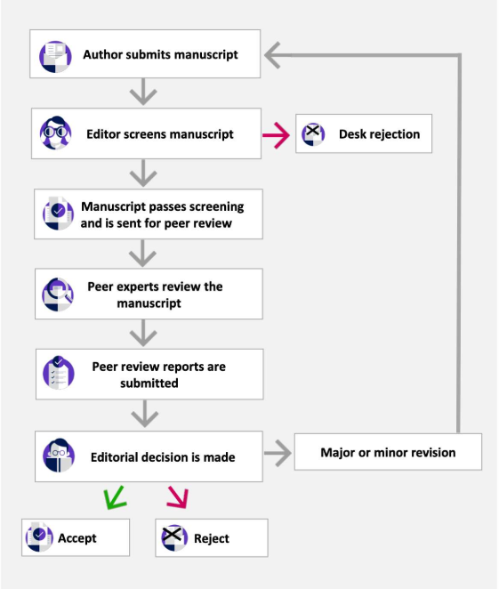
The Peer Review process
Peer review is the quality-control process that allows us to trust and build on published research.
Notes:
Mention fake news and predatory publishers

Slide 6
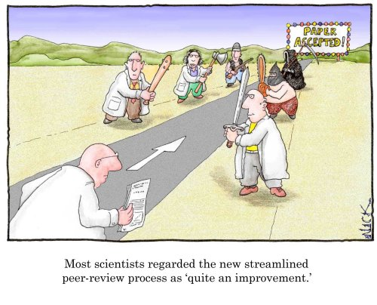

Slide 7
Poll question 1:
Have you peer reviewed for a journal?
Notes:
Q: Have you peer reviewed for a journal?
A: No, I have not received an invitation yet
B: No, I have declined the invitation(s) I’ve received
C: Yes

Slide 8
2. Providing useful and constructive peer reviews

Slide 9
Before you start your peer review
Check the journal’s guidelines on the journal’s website or linked to in the invitation to peer review email
Log in to the review submission portal and look for any structured forms and make sure you have access to all supplementary files
Set a time to complete your peer review before the deadline
Notes:
With the form – is there anything in particular you’ll be asked to comment on e.g the novelty of the research?

Slide 10
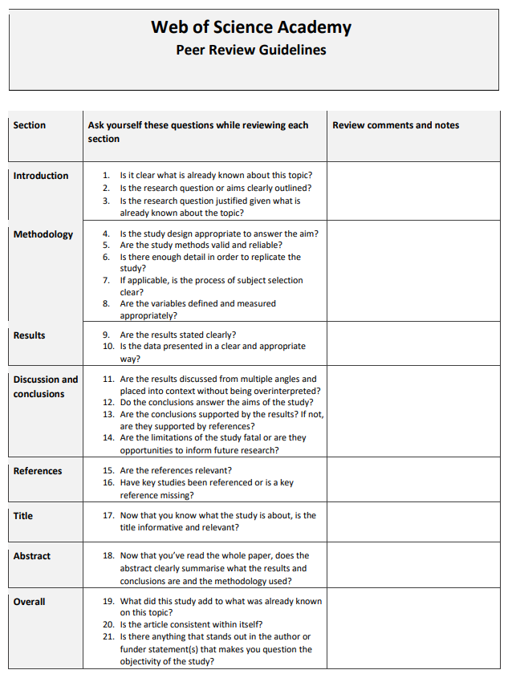
Peer Review guidelines
The Web of Science Academy has a peer review guidelines document.
The journal may also have their own guidelines or form with specific questions to help you with your peer review.

Slide 11
Constructive feedback
STATEMENT – clearly state where the issue is
EXPLAIN – explain WHY it is an issue
EXAMPLE – provide an example with evidence to support your statement and where possible provide a possible solution
Using the S.E.E method

Slide 12
Introduction
Is it clear what is already known about this topic?
Is the research question or aims clearly outlined?
Is the research question justified given what is already known about the topic?
What to look for in an introduction section of a manuscript.

Slide 13
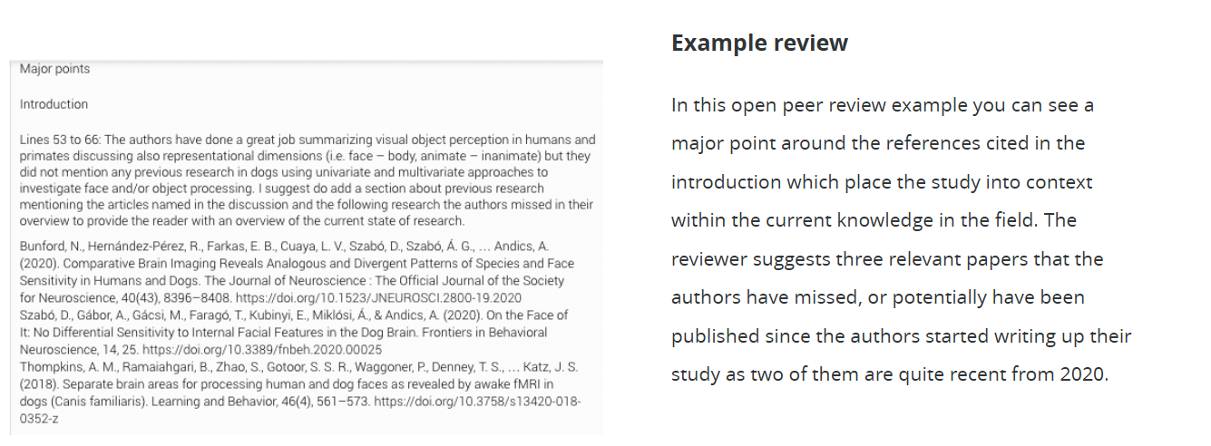

Slide 14
Methodology
Is the study design appropriate to answer the aim?
Are the study methods valid and reliable?
Is there enough detail in order to replicate the study?
If applicable, is the process of subject selection clear?
Are the variables defined and measured appropriately?
What to look for in a methodology section of a manuscript.
Notes:
Subject selection – representation of a larger population. Is there any sampling bias? This could be mentioned as a limitation in the discussion and taken into consideration when looking at the results and conclusions. E.g Opportunity sampling – most convenient subjects sampled, volunteer sampling – may share personality traits

Slide 15
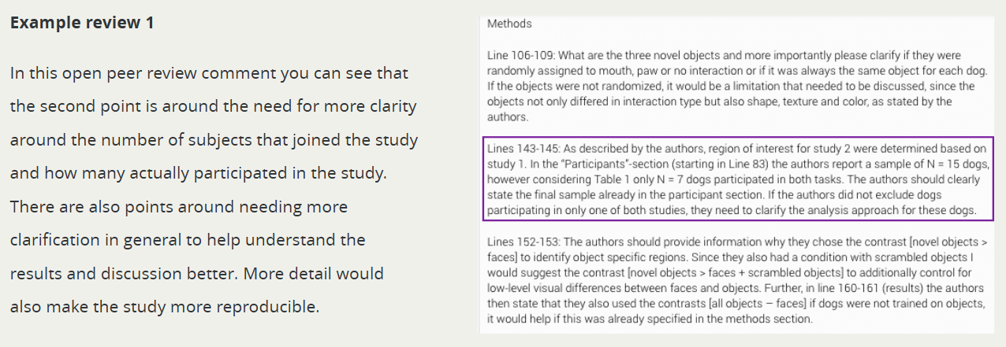

Slide 16
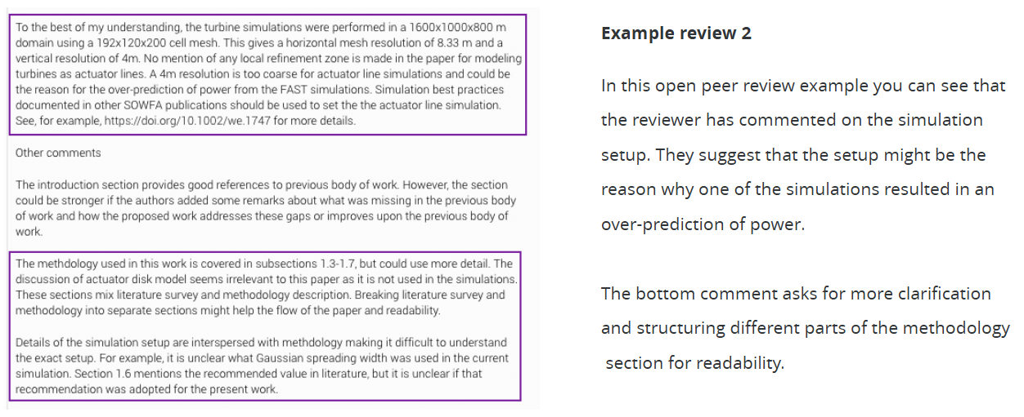

Slide 17
Results
Are the results clearly stated?
Is the data presented in a clear and appropriate way?
What to look for in the results section of a manuscript.
Notes:
Should be no discussion in this section!! Graphs and tables should be clear and useful/helpful to the reader.

Slide 18
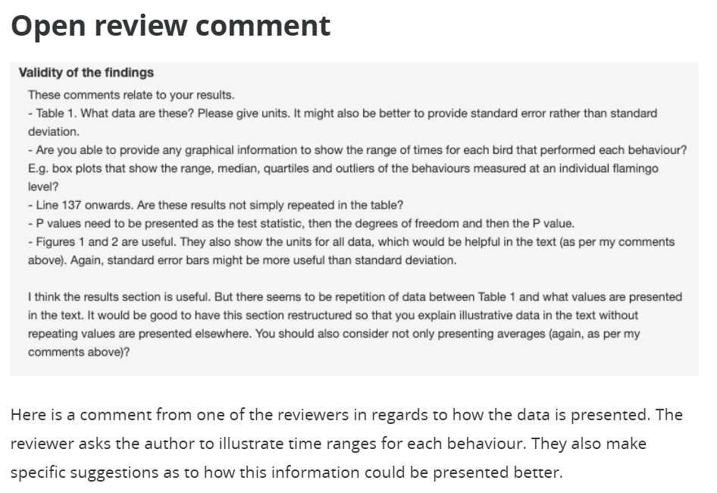

Slide 19
Discussion and conclusions
Are the results discussed from multiple angles and placed into context without being overinterpreted?
Do the conclusions answer the aims of the study?
Are the conclusions supported by the results? If not, are they supported by references?
Are the limitations of the study fatal or are they opportunities to inform future research?
What to look for in the discussion and conclusion section of a manuscript.

Slide 20
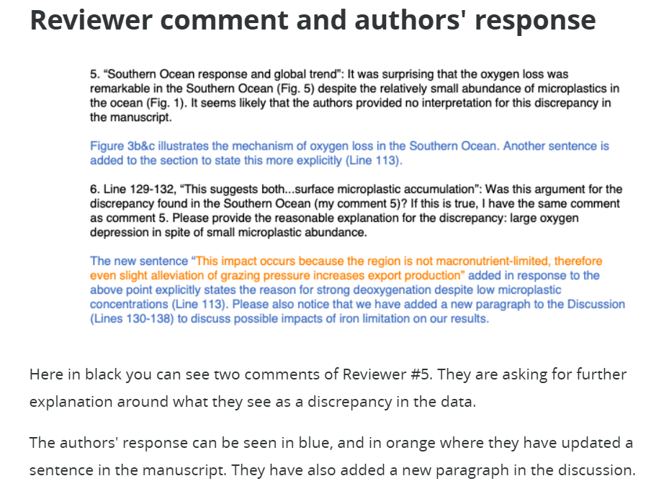

Slide 21
Abstract
Now that you have read the whole paper, does the abstract clearly summarise what the results and conclusions are and the methodology used?
What to look for in the abstract of a manuscript.

Slide 22
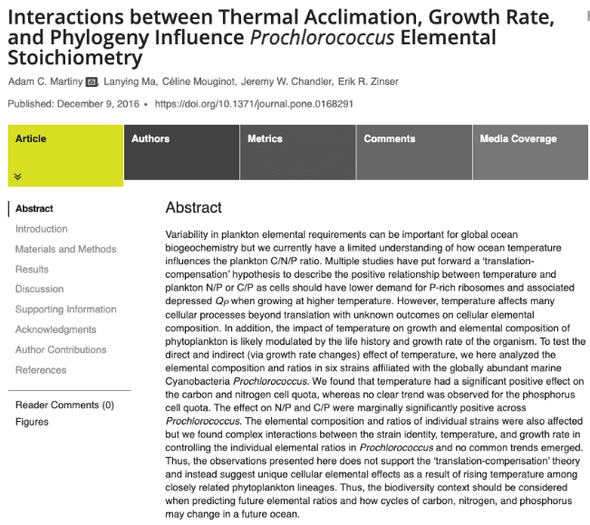
General background

Slide 23
Specific background

Slide 24
Gap in knowledge

Slide 25
Methodology used

Slide 26
Summary of the results

Slide 27
Conclusions

Slide 28
Relevance and practical application

Slide 29
Title
Now that you know what the study is about, is the title informative and relevant?
Does the title overstate the scope or findings of the study?
What to look for in the title of a manuscript.

Slide 30
References
Are the references relevant?
Have key studies been referenced or is a key reference missing?
What to look for in the references section of a manuscript.

Slide 31
Overall
What did this study add to what was already known on this topic?
Is the article consistent within itself?
Is there anything that stands out in the author or funder statement(s) that makes you question the objectivity of the study?
What to look for in the whole manuscript.

Slide 32
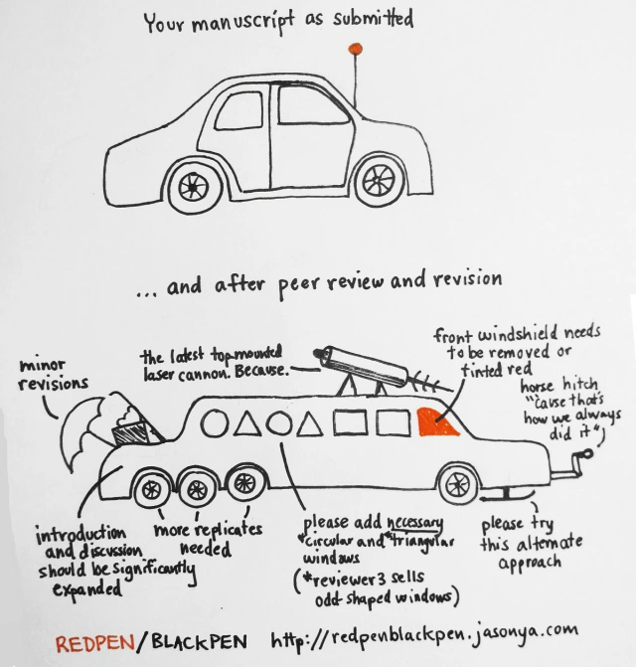
Notes:
As an author you do not HAVE to make all the changes the reviewers suggest!! If you can argue/discuss good reasons for why and the editor accepts your arguments.

Slide 33
3. Using a peer review template to structure your feedback

Slide 34
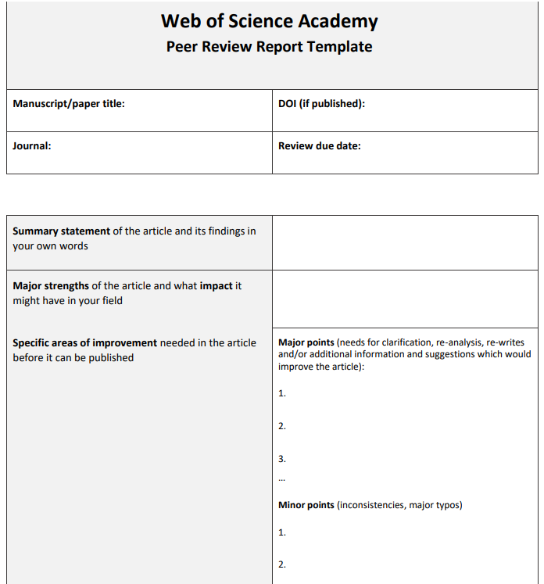
Why use a template?
Can help you peer review consistently and fairly.
Helps you structure your peer review comments.
Notes:
Could also be a section with confidential comments to the editor

Slide 35
Constructive feedback
STATEMENT – clearly state where the issue is
EXPLAIN – explain WHY it is an issue
EXAMPLE – provide an example with evidence to support your statement and where possible provide a possible solution
Using the S.E.E method

Slide 36
Poll question 2:
Can you describe your current experience with the peer review process as an author?
Notes:
Q: What is your current experience with peer review as an author?
A: Positive, comments are usually constructive and helpful and improved my manuscript
B: Mixed, sometimes they were helpful, sometimes not helpful at all
C: Somewhat negative, I have not received constructive and helpful peer reviews yet

Slide 37
4. Tips and recommendations

Slide 38
Tips and recommendations
Don’t shy away from your first invitations to peer review, they can benefit you, as being a good peer reviewer makes you a better writer as you can scrutinise your own manuscript from a peer reviewer’s perspective!
Notes:
Share my first experience of peer review – bit nervous but when I saw that the other peer reviewers had picked up on similar things I felt more confident and I also picked up on some things the others hadn’t!

Slide 39
Tips and recommendations
Don’t shy away from your first invitations to peer review, they can benefit you, as being a good peer reviewer makes you a better writer as you can scrutinise your own manuscript from a peer reviewer’s perspective!
Notes:
Share my first experience of peer review – bit nervous but when I saw that the other peer reviewers had picked up on similar things I felt more confident and I also picked up on some things the others hadn’t!

Slide 40


Tips and recommendations
Learn from open peer reviews
Practise by writing post-publication peer reviews of pre-prints
Co-review with your supervisor/senior colleague or friend

Slide 41
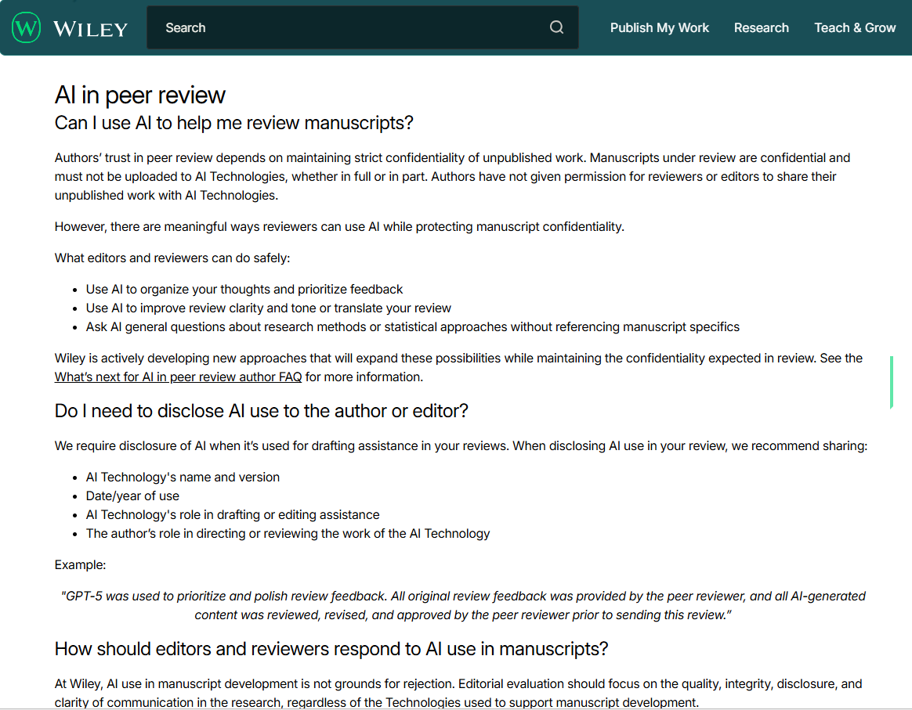
Tips and recommendations
Do NOT upload manuscripts under peer review to GenAI tools!
Check if the journal allows use of AI for structuring and reformatting your comments, and for spelling and grammar

Slide 42
Thank you for listening, any questions?
Contacts:
julia.vilstrup.mouatt@auckland.ac.nz
maria.dams@auckland.ac.nz

